Slide 1

Shri Vaishnav Vidhyapeeth Vishwavidayalaya
Shri Vaishnav Institute of Information Technology
Indore-Ujjain Road, Indore-453111
Academic Session June-Dec 2024
Laboratory Manual
Course Name:- Fundamentals Of Data Structure Course Code:- BTCS306M
Submitted To:- Prof. Pritesh Kumar Jain
Submitted By:- Sarthak Gupta
Enrollment No.:- 23100BTAIMLM14562

Slide 2
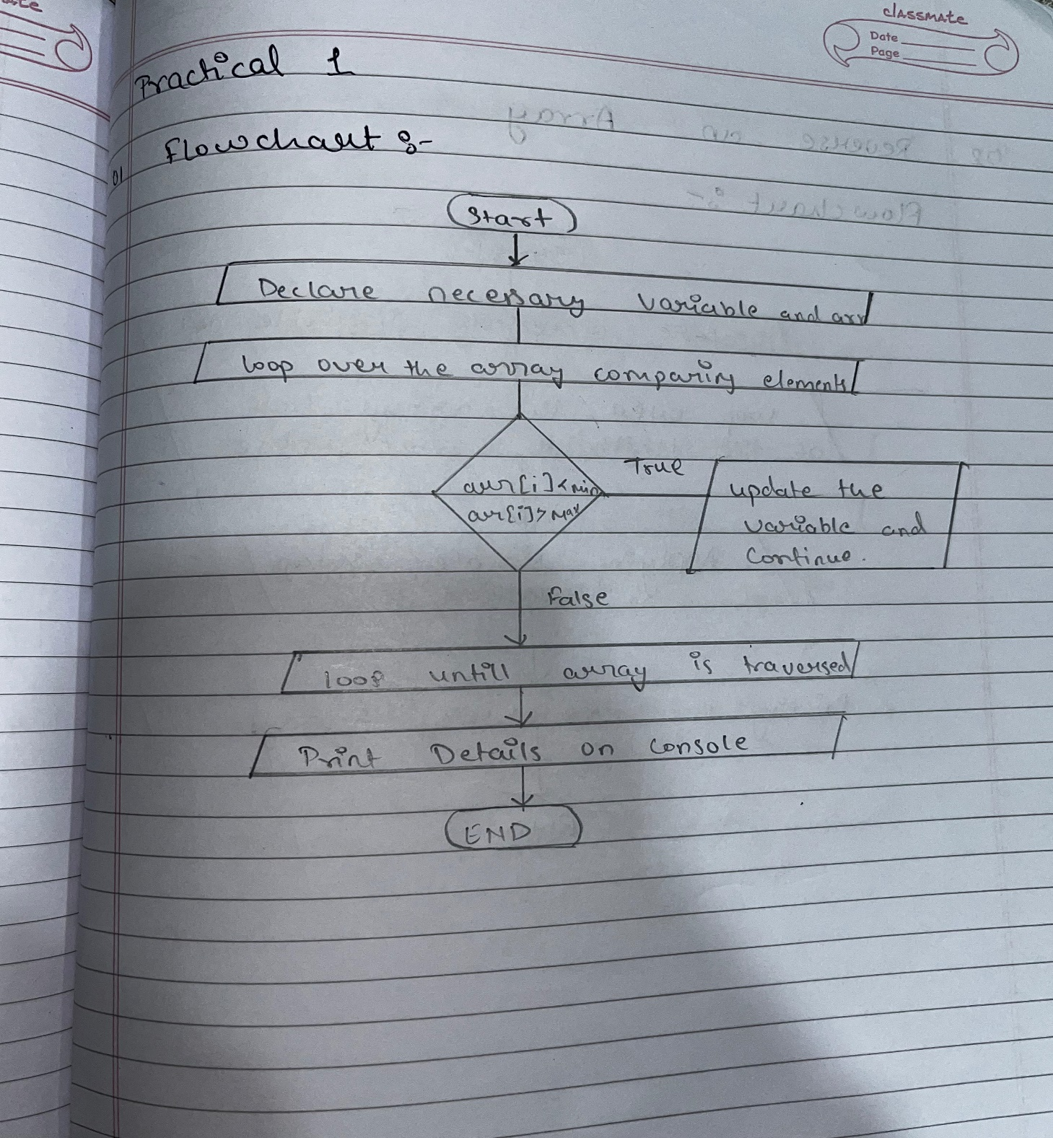
Shri Vaishnav Vidhyapeeth Vishwavidayalaya
Shri Vaishnav Institute of Information Technology
Indore-Ujjain Road, Indore-453111
Program No.:- 01
Find the Maximum and Minimum Elements:-
Aim:- write a program to find the maximum and minimum elements in an array.
Theory:-

Slide 3
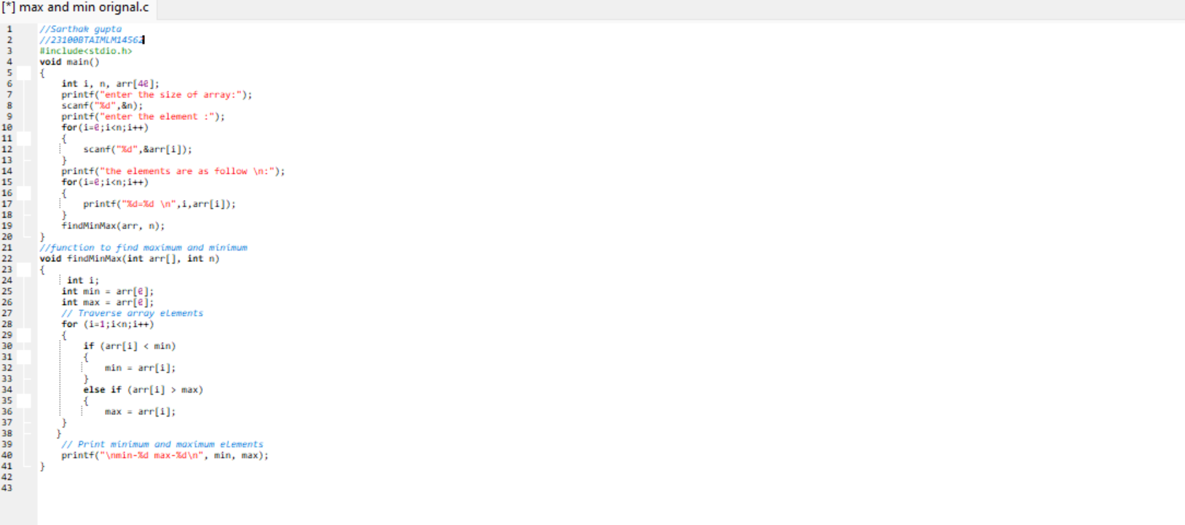
Shri Vaishnav Vidhyapeeth Vishwavidayalaya
Shri Vaishnav Institute of Information Technology
Indore-Ujjain Road, Indore-453111
Input:-

Slide 4
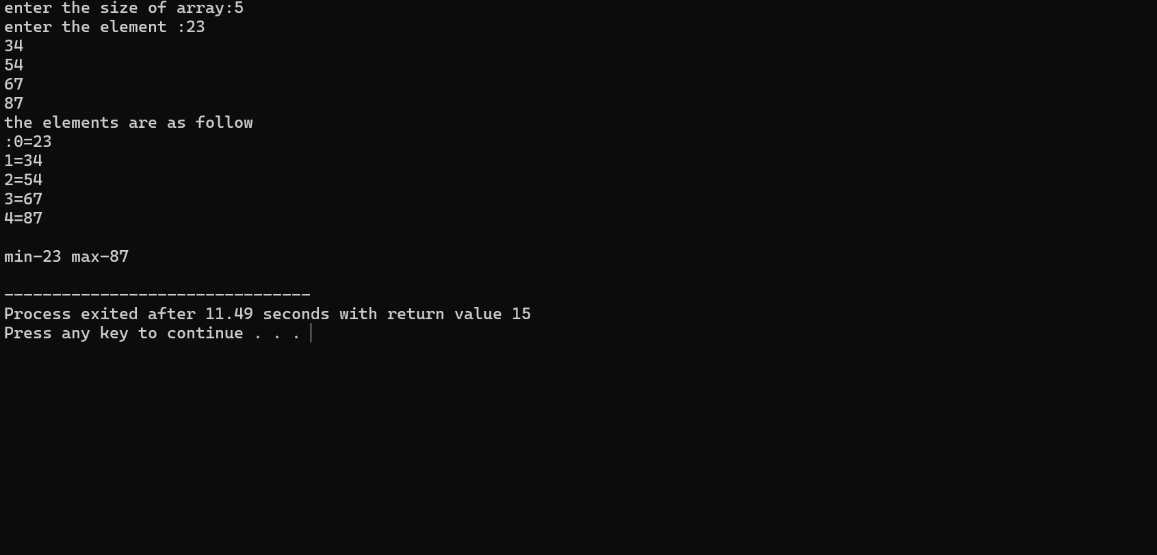
Shri Vaishnav Vidhyapeeth Vishwavidayalaya
Shri Vaishnav Institute of Information Technology
Indore-Ujjain Road, Indore-453111
Output:-

Slide 5
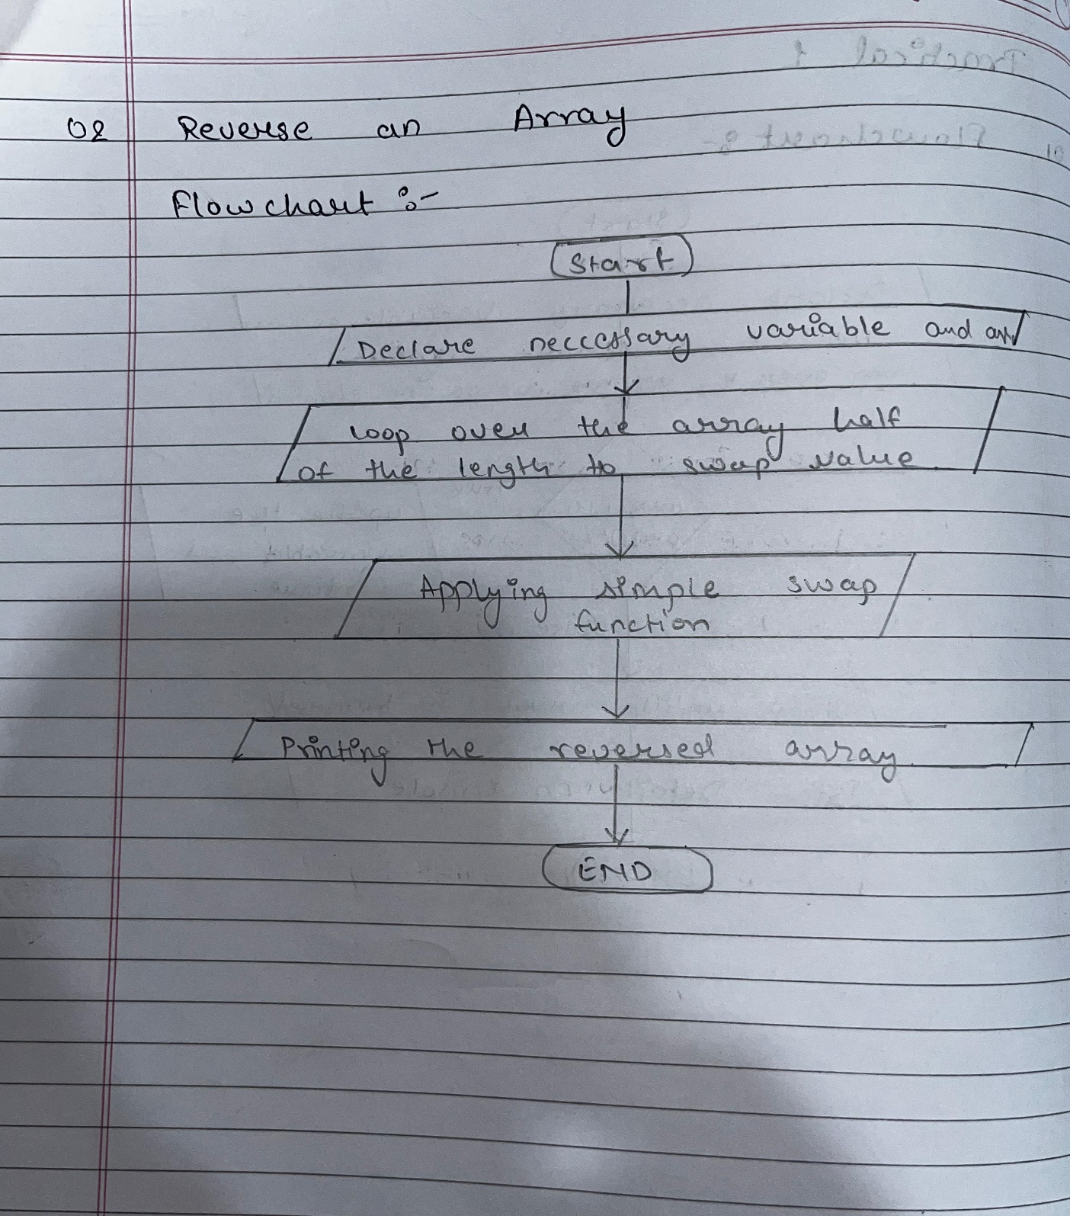
Shri Vaishnav Vidhyapeeth Vishwavidayalaya
Shri Vaishnav Institute of Information Technology
Indore-Ujjain Road, Indore-453111
Reverse An Array:-
Aim:- Implement a function to reverse the elements of an array in place.
Theory:-

Slide 6
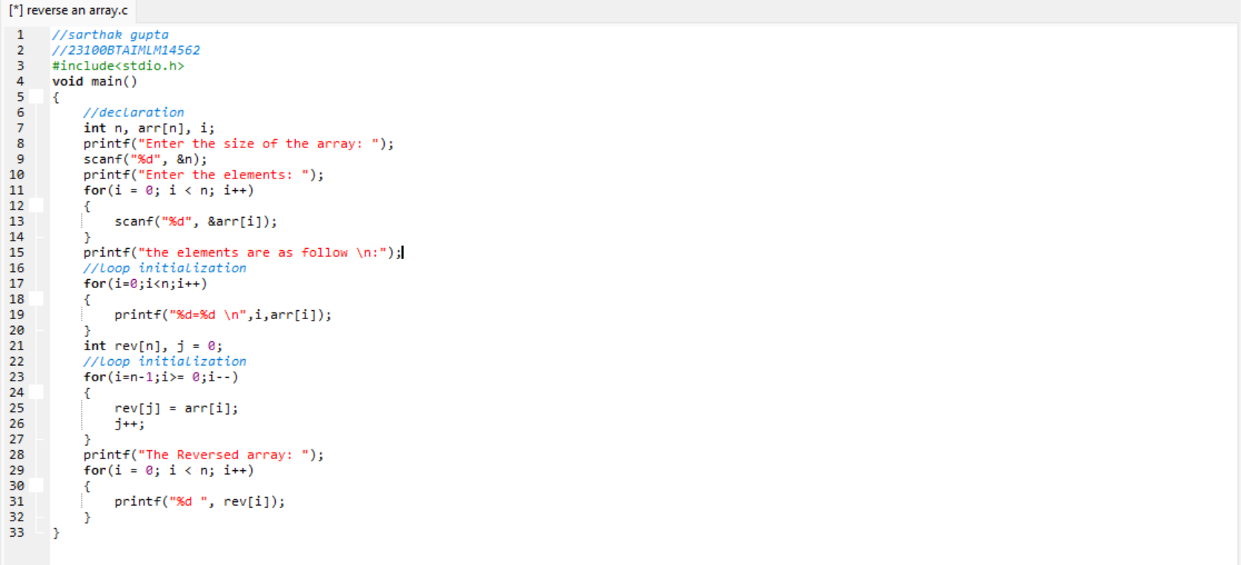
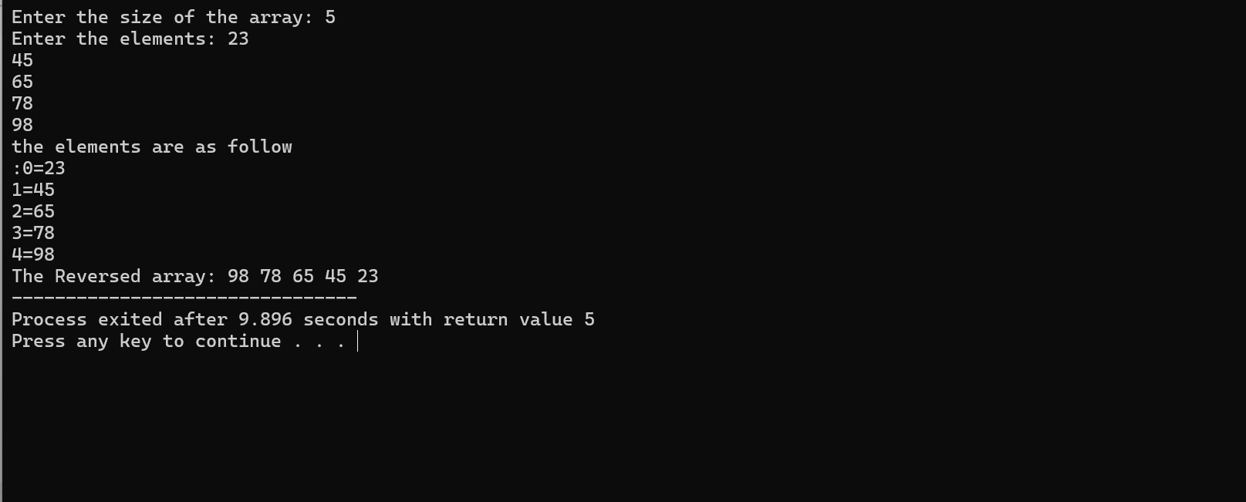
Shri Vaishnav Vidhyapeeth Vishwavidayalaya
Shri Vaishnav Institute of Information Technology
Indore-Ujjain Road, Indore-453111
Input:-
Output:-

Slide 7
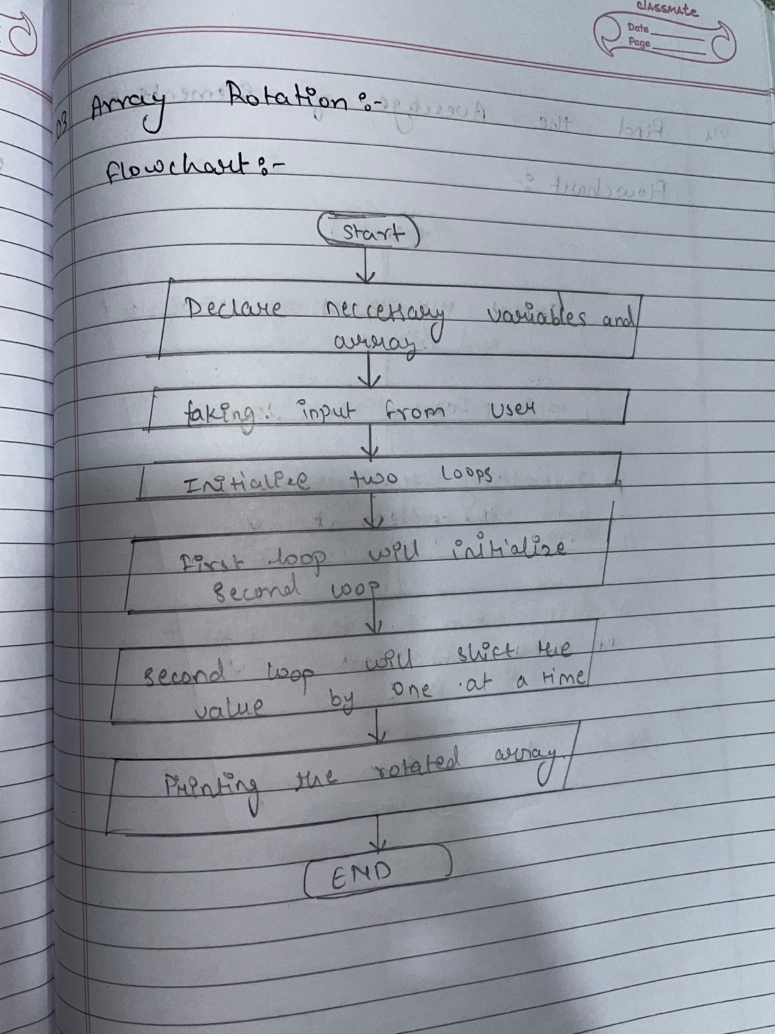
Shri Vaishnav Vidhyapeeth Vishwavidayalaya
Shri Vaishnav Institute of Information Technology
Indore-Ujjain Road, Indore-453111
Array Rotation:-
Aim:- Create a function to rotate an array to the right or left by a given number of positions.
Theory:-

Slide 8
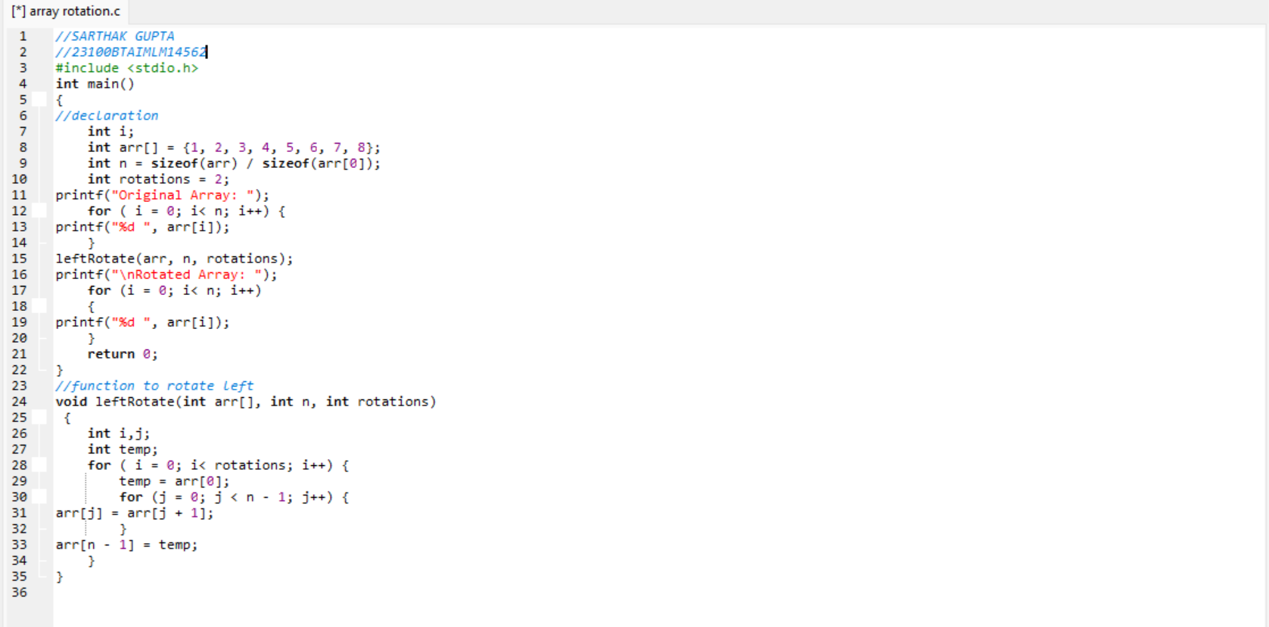
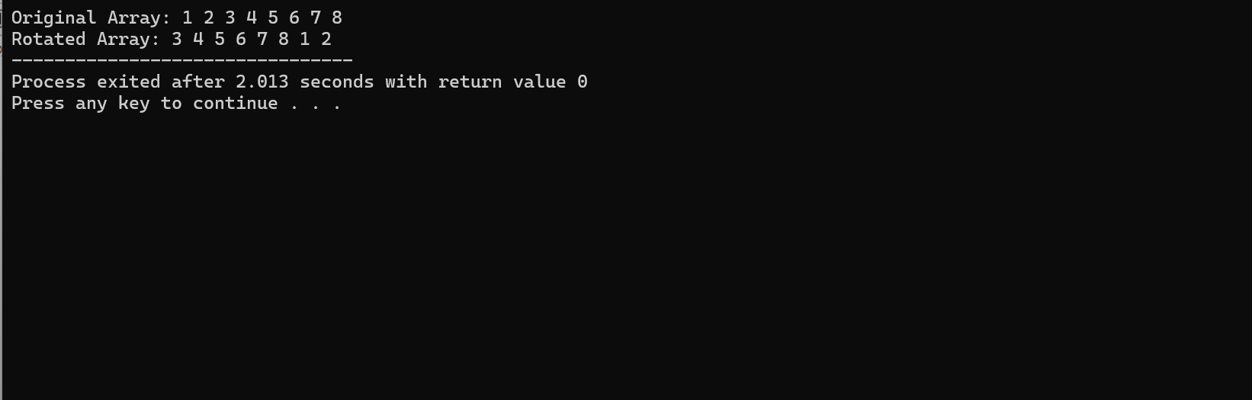
Shri Vaishnav Vidhyapeeth Vishwavidayalaya
Shri Vaishnav Institute of Information Technology
Indore-Ujjain Road, Indore-453111
Input:-
Output:-

Slide 9
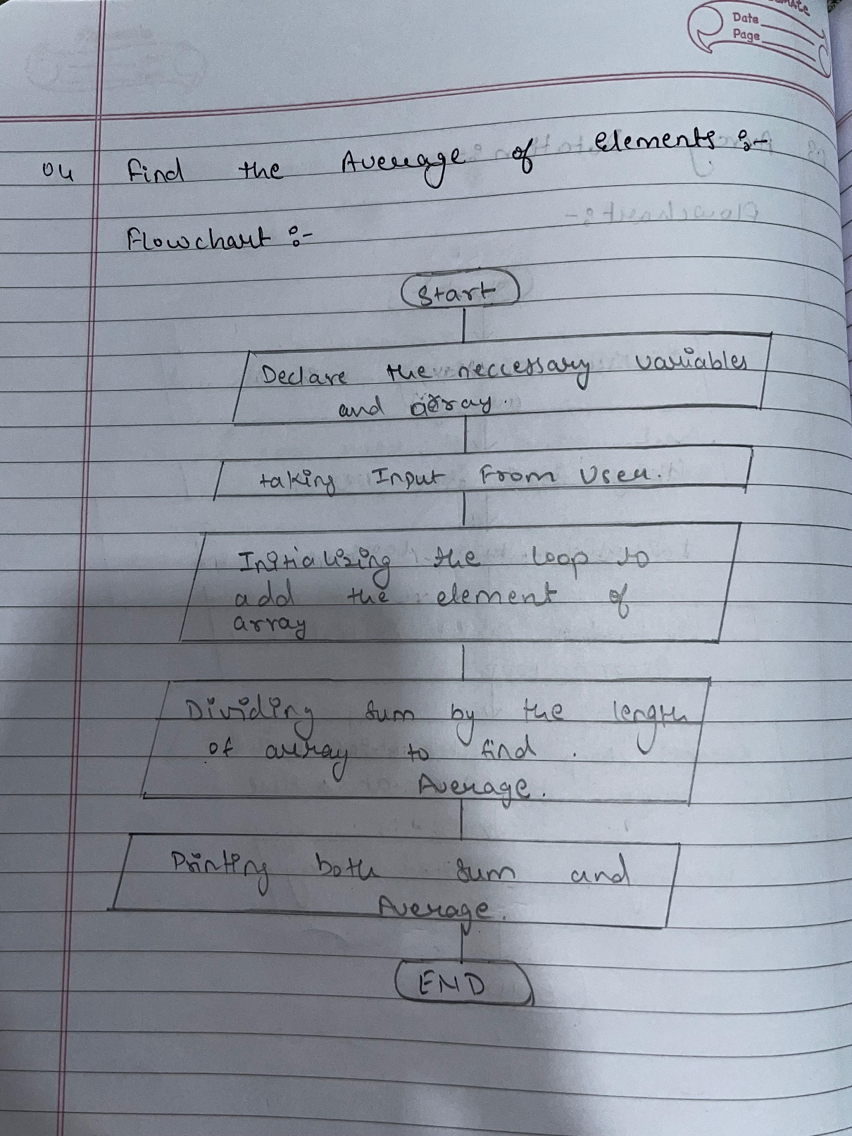
Shri Vaishnav Vidhyapeeth Vishwavidayalaya
Shri Vaishnav Institute of Information Technology
Indore-Ujjain Road, Indore-453111
Find the Average of Elements:-
Aim:- Write a program to calculate of all elements in an array.
Theory:-

Slide 10
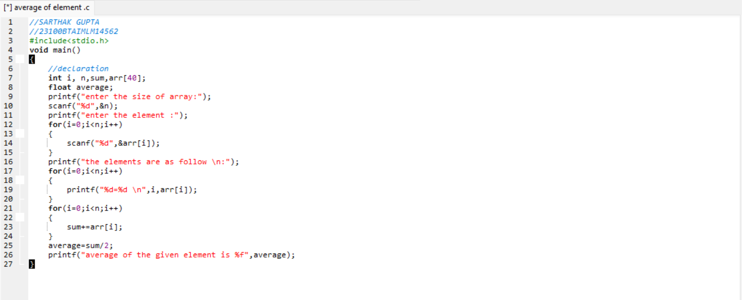
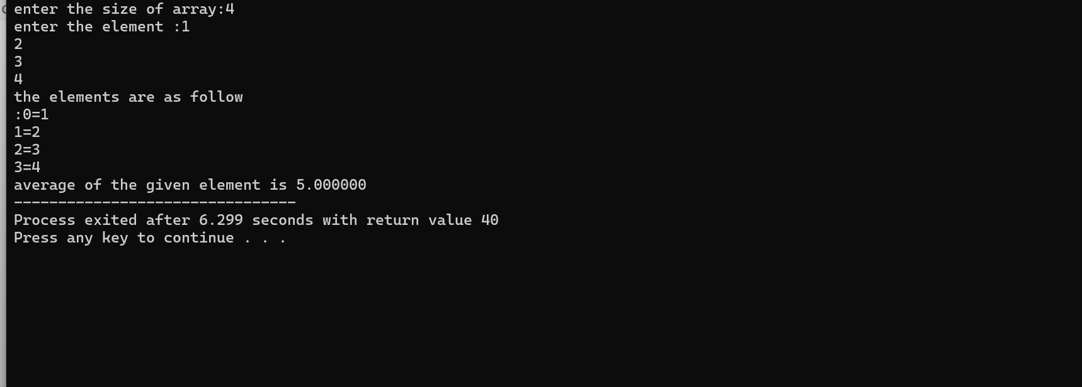
Shri Vaishnav Vidhyapeeth Vishwavidayalaya
Shri Vaishnav Institute of Information Technology
Indore-Ujjain Road, Indore-453111
Input:-
Output:-

Slide 11
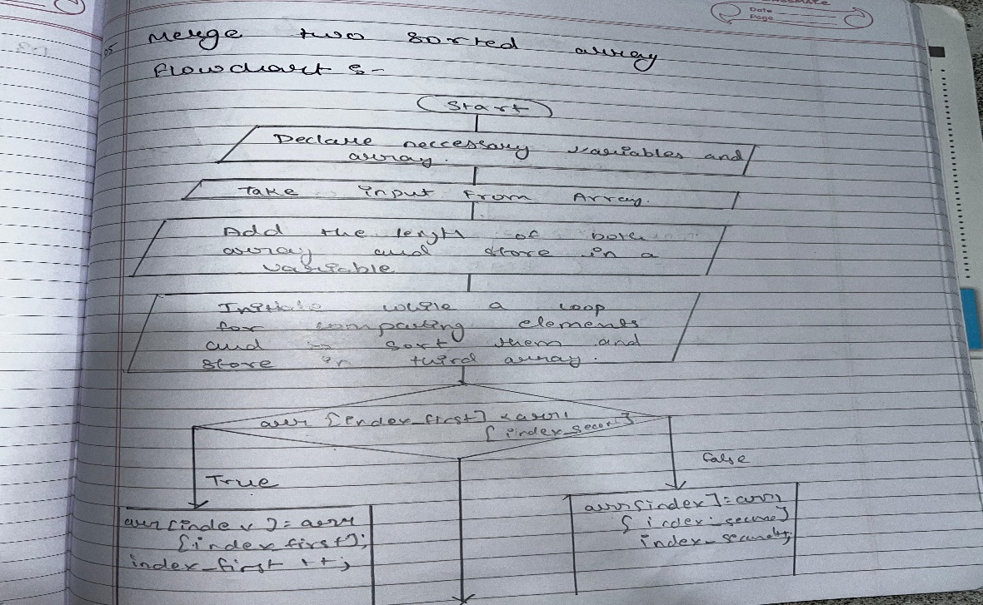
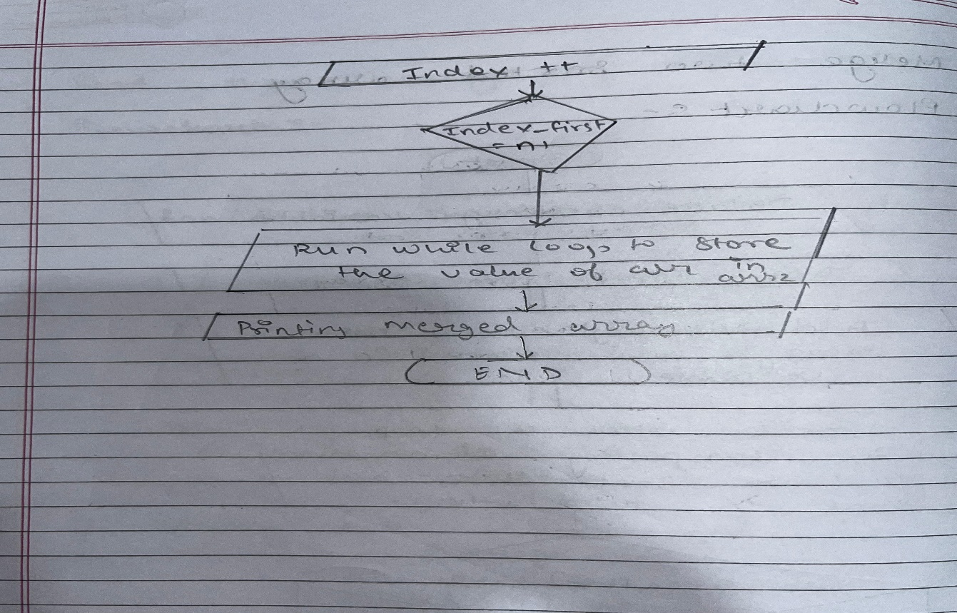
Shri Vaishnav Vidhyapeeth Vishwavidayalaya
Shri Vaishnav Institute of Information Technology
Indore-Ujjain Road, Indore-453111
Merge Two Sorted Array.
Aim:- write a program to merge two sorted array.
Theory:-
10

Slide 12
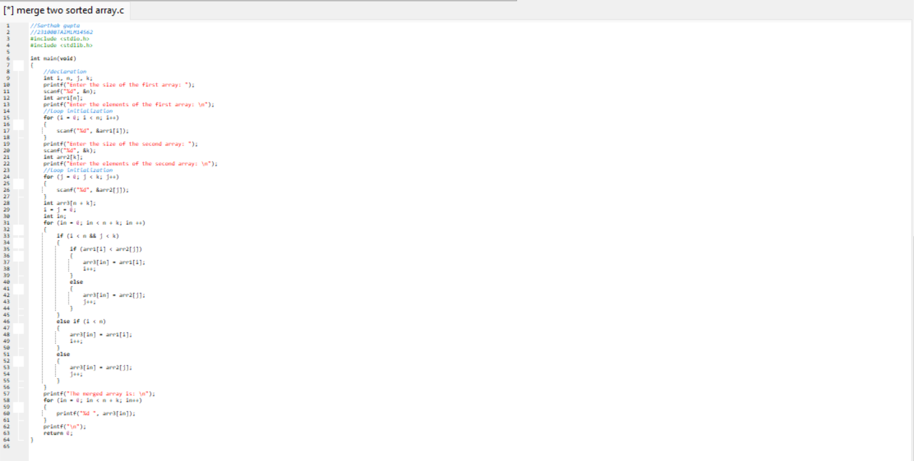
Shri Vaishnav Vidhyapeeth Vishwavidayalaya
Shri Vaishnav Institute of Information Technology
Indore-Ujjain Road, Indore-453111
Input:-

Slide 13
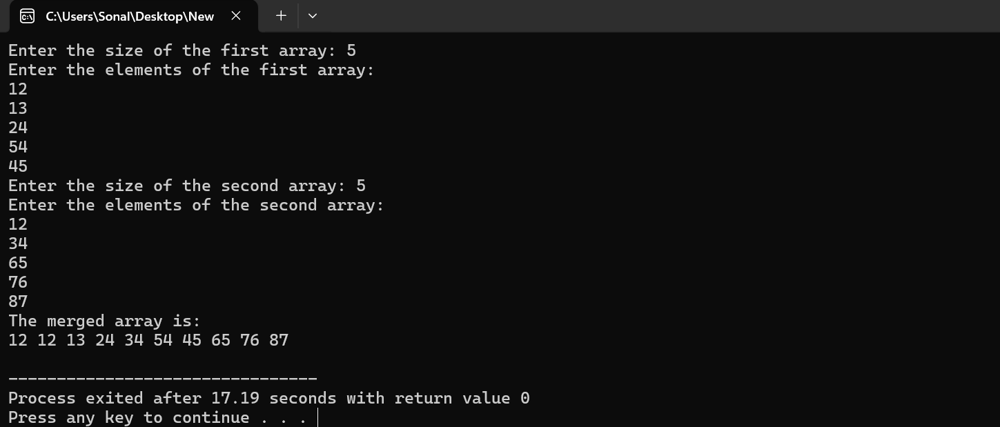
Shri Vaishnav Vidhyapeeth Vishwavidayalaya
Shri Vaishnav Institute of Information Technology
Indore-Ujjain Road, Indore-453111
Output:-

Slide 14
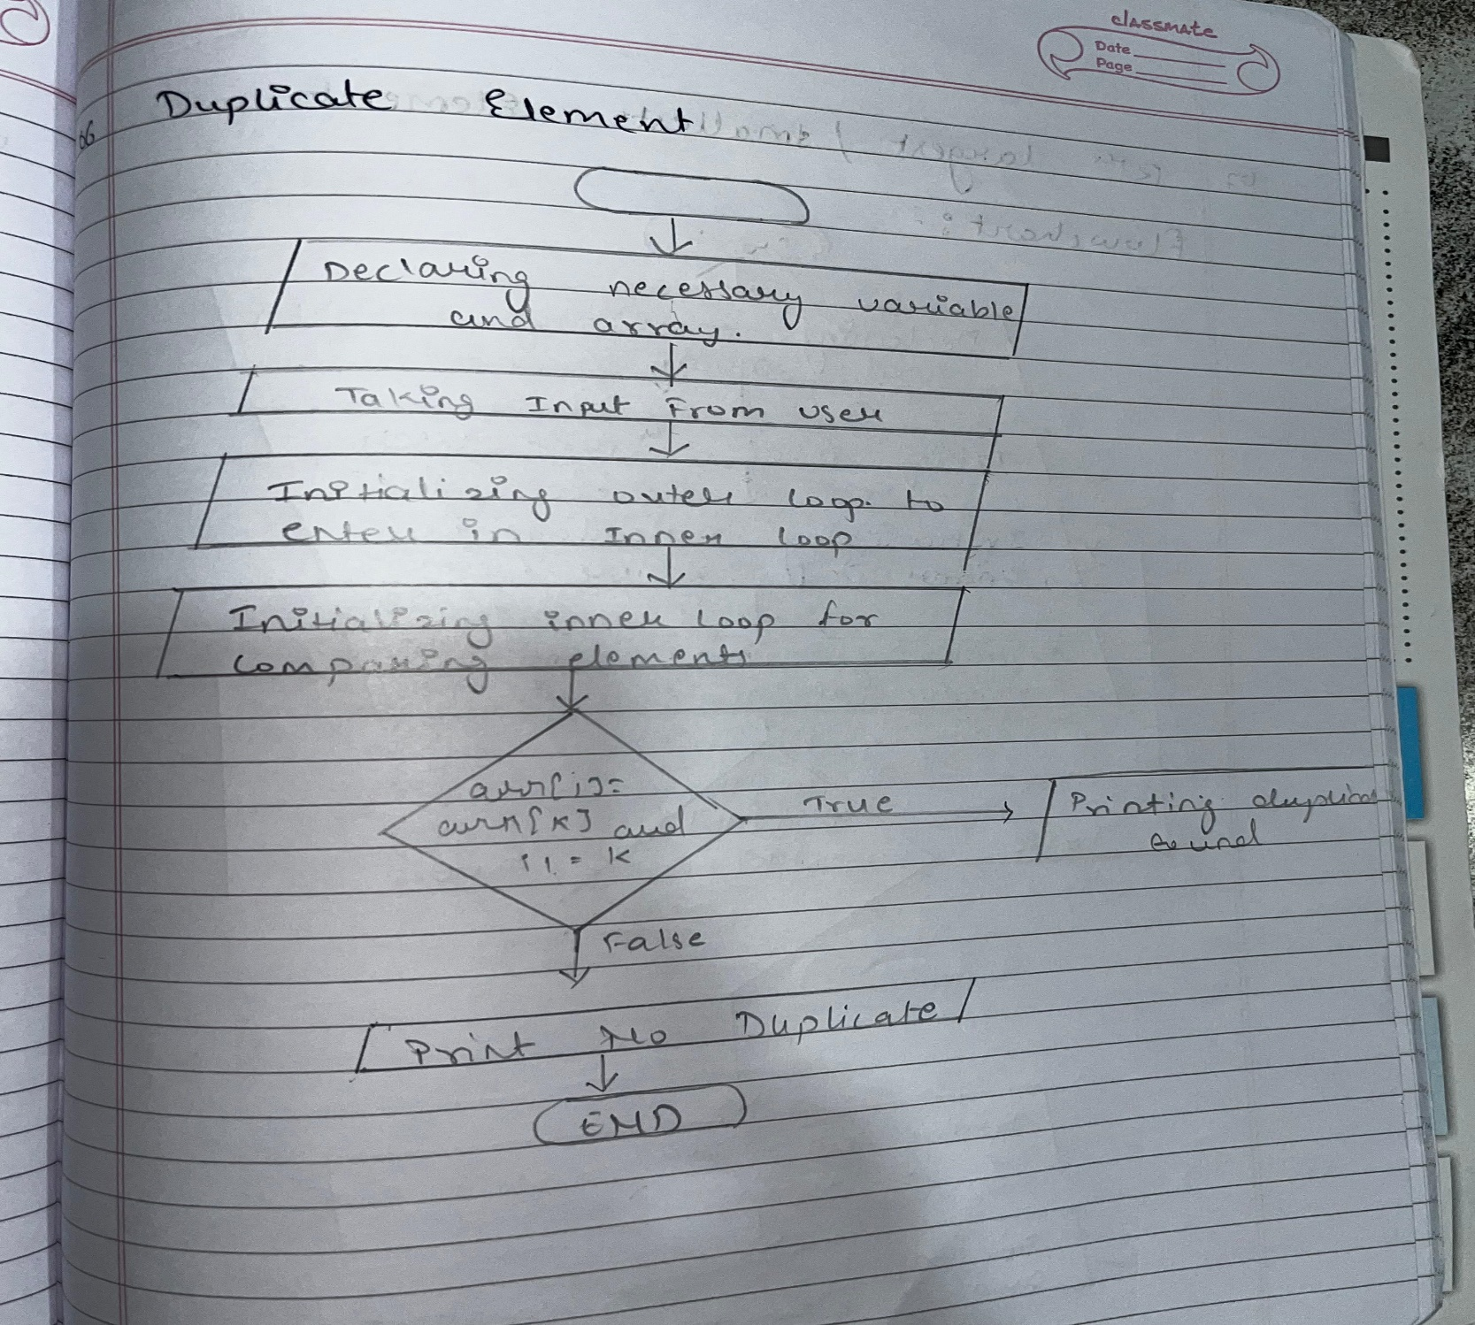
Shri Vaishnav Vidhyapeeth Vishwavidayalaya
Shri Vaishnav Institute of Information Technology
Indore-Ujjain Road, Indore-453111
Check For Duplicate Elements:-
Aim:- write a program to check if an array contains any duplicate elements.
Theory:-

Slide 15
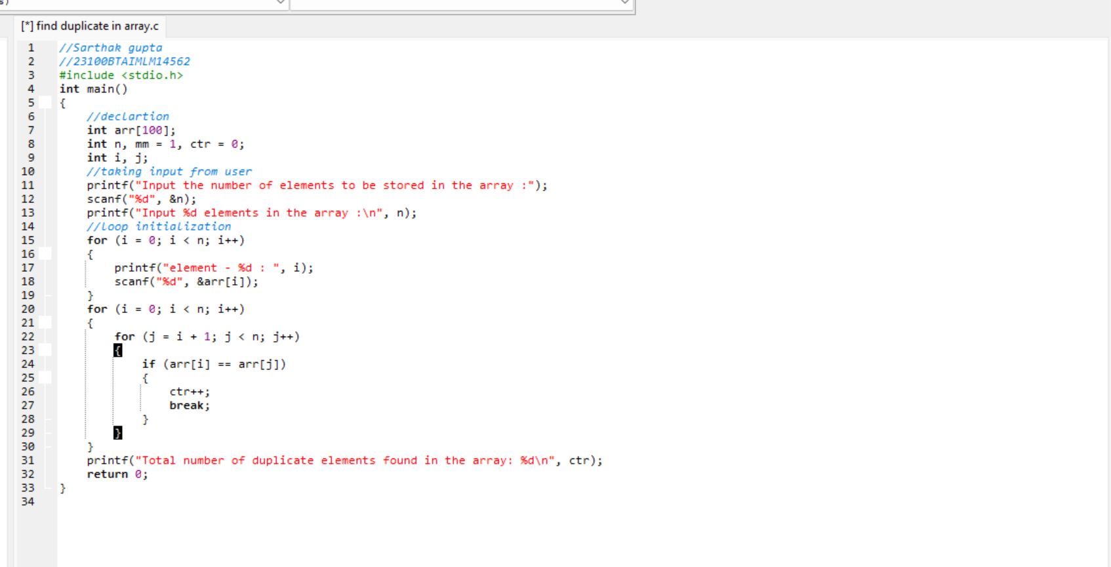
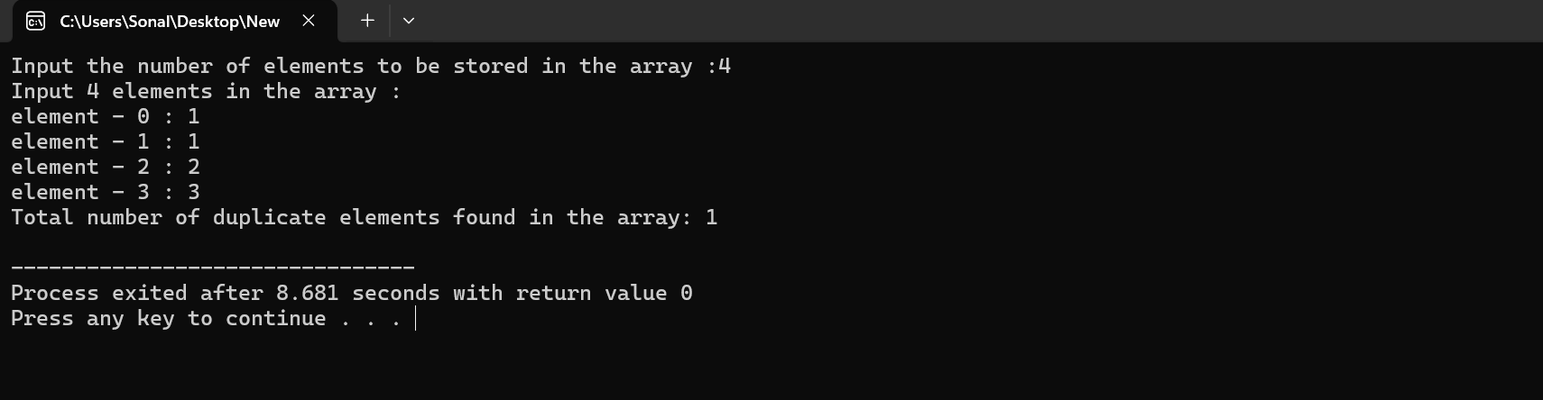
Shri Vaishnav Vidhyapeeth Vishwavidayalaya
Shri Vaishnav Institute of Information Technology
Indore-Ujjain Road, Indore-453111
Input:-
Output:-

Slide 16
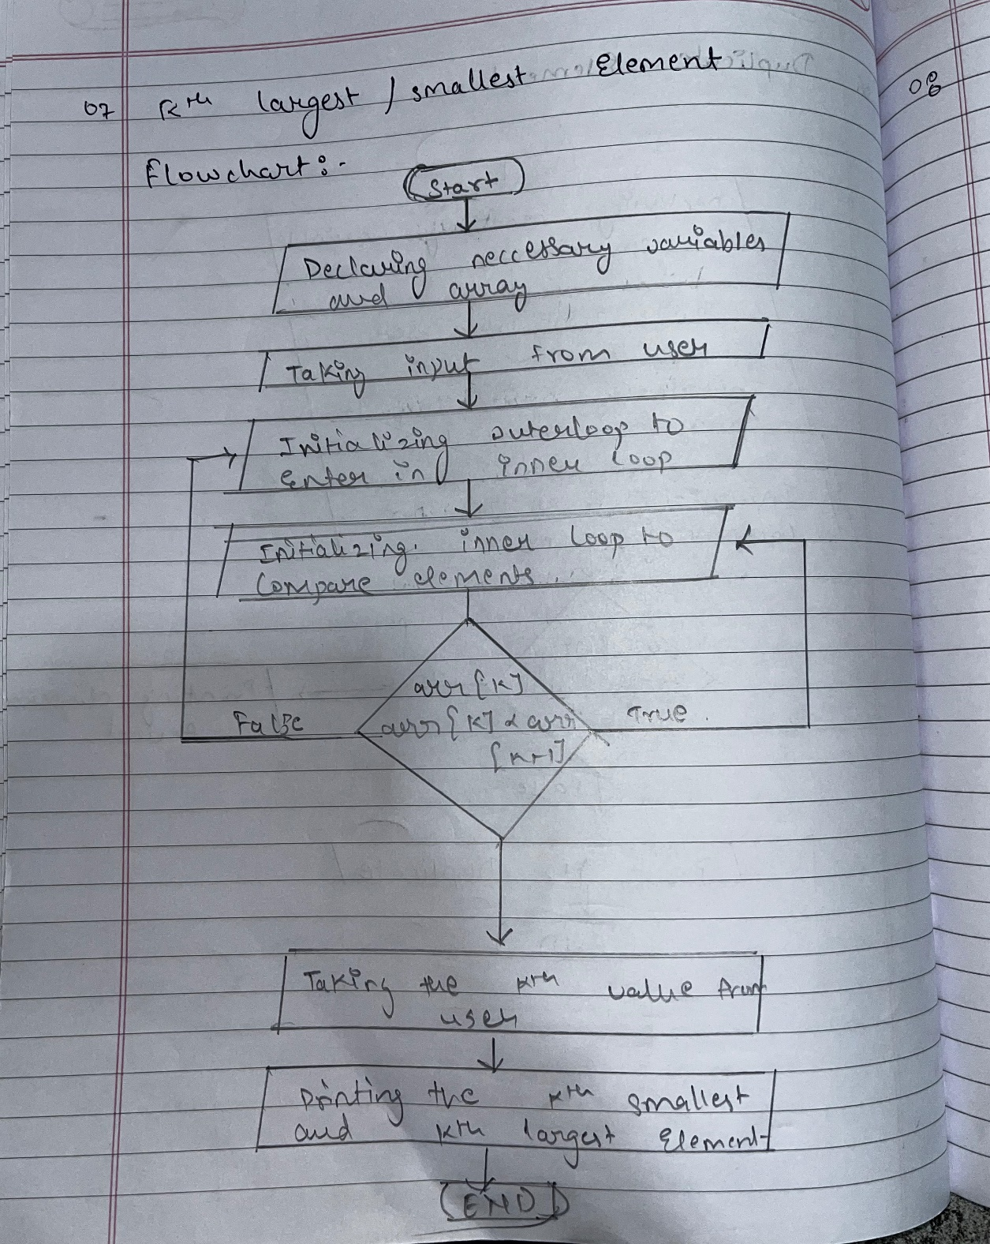
Shri Vaishnav Vidhyapeeth Vishwavidayalaya
Shri Vaishnav Institute of Information Technology
Indore-Ujjain Road, Indore-453111
Find The Kth Largest/Smallest Elements:-
Aim:- implement a function to find the kth largest or smallest element in an unsorted array.
Theory:-

Slide 17
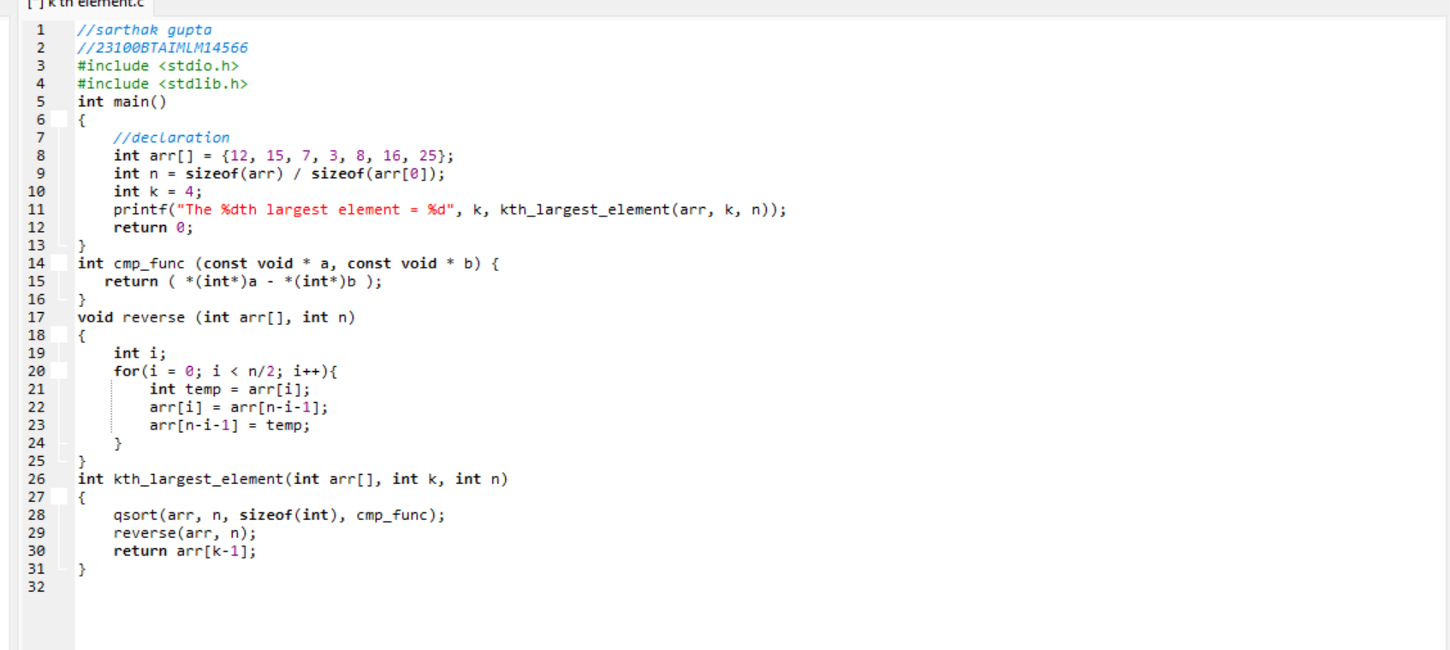
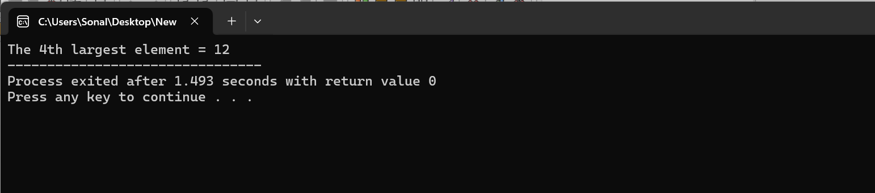
Shri Vaishnav Vidhyapeeth Vishwavidayalaya
Shri Vaishnav Institute of Information Technology
Indore-Ujjain Road, Indore-453111
Input:-
Output:-

Slide 18
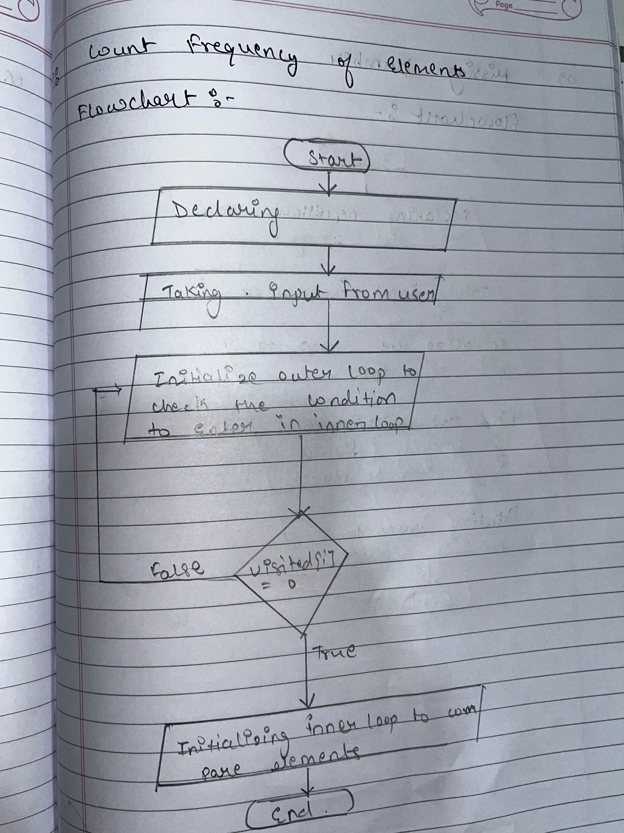
Shri Vaishnav Vidhyapeeth Vishwavidayalaya
Shri Vaishnav Institute of Information Technology
Indore-Ujjain Road, Indore-453111
Count Frequency of Element:-
Aim:- Create a function to count the frequency of each element in an array and display it.
Theory:-

Slide 19
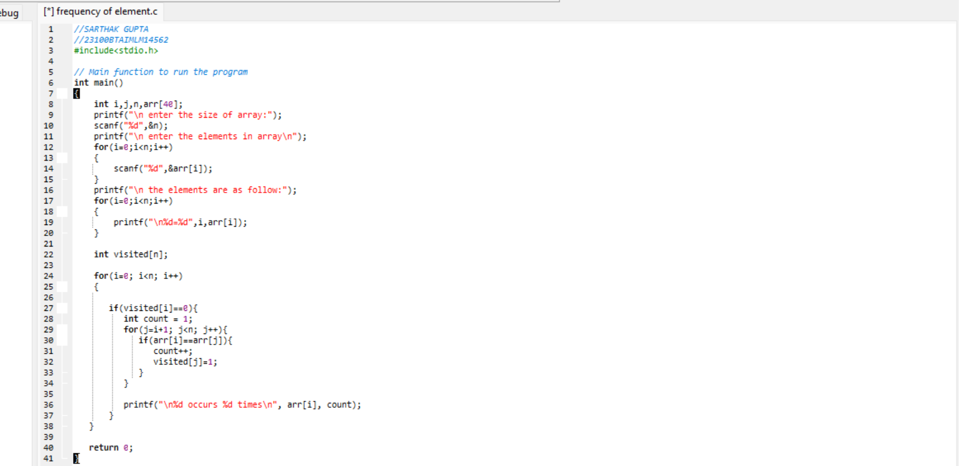
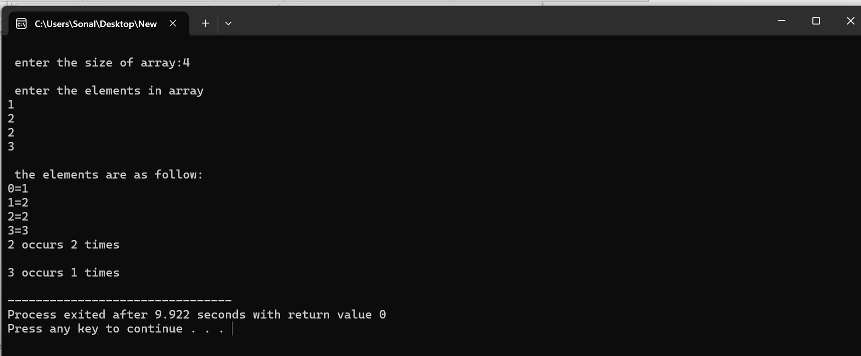
Shri Vaishnav Vidhyapeeth Vishwavidayalaya
Shri Vaishnav Institute of Information Technology
Indore-Ujjain Road, Indore-453111
Input:-
Output:-

Slide 20
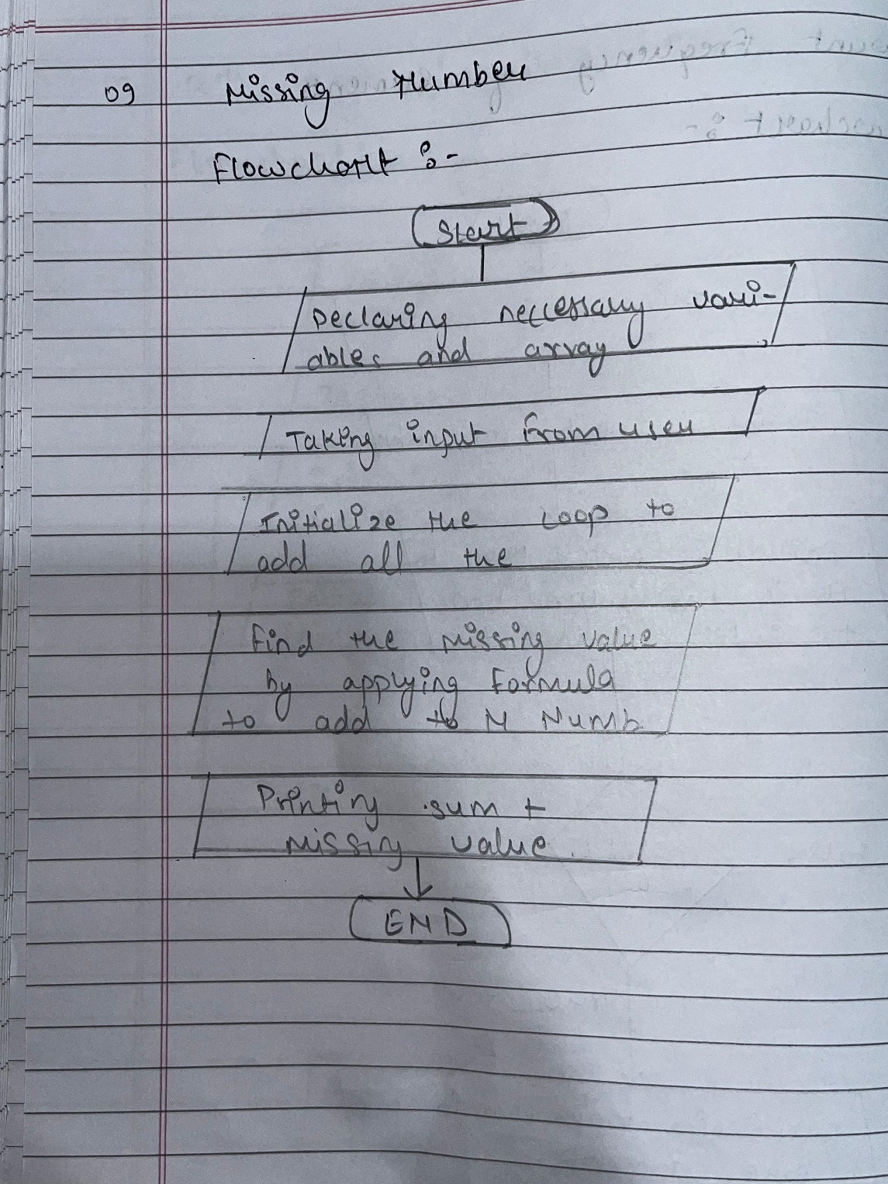
Shri Vaishnav Vidhyapeeth Vishwavidayalaya
Shri Vaishnav Institute of Information Technology
Indore-Ujjain Road, Indore-453111
Finding The Missing Number:-
Aim:- Given an array of integer from 1 to N with one number missing, write a program to find the missing number.
Theory:-
20

Slide 21
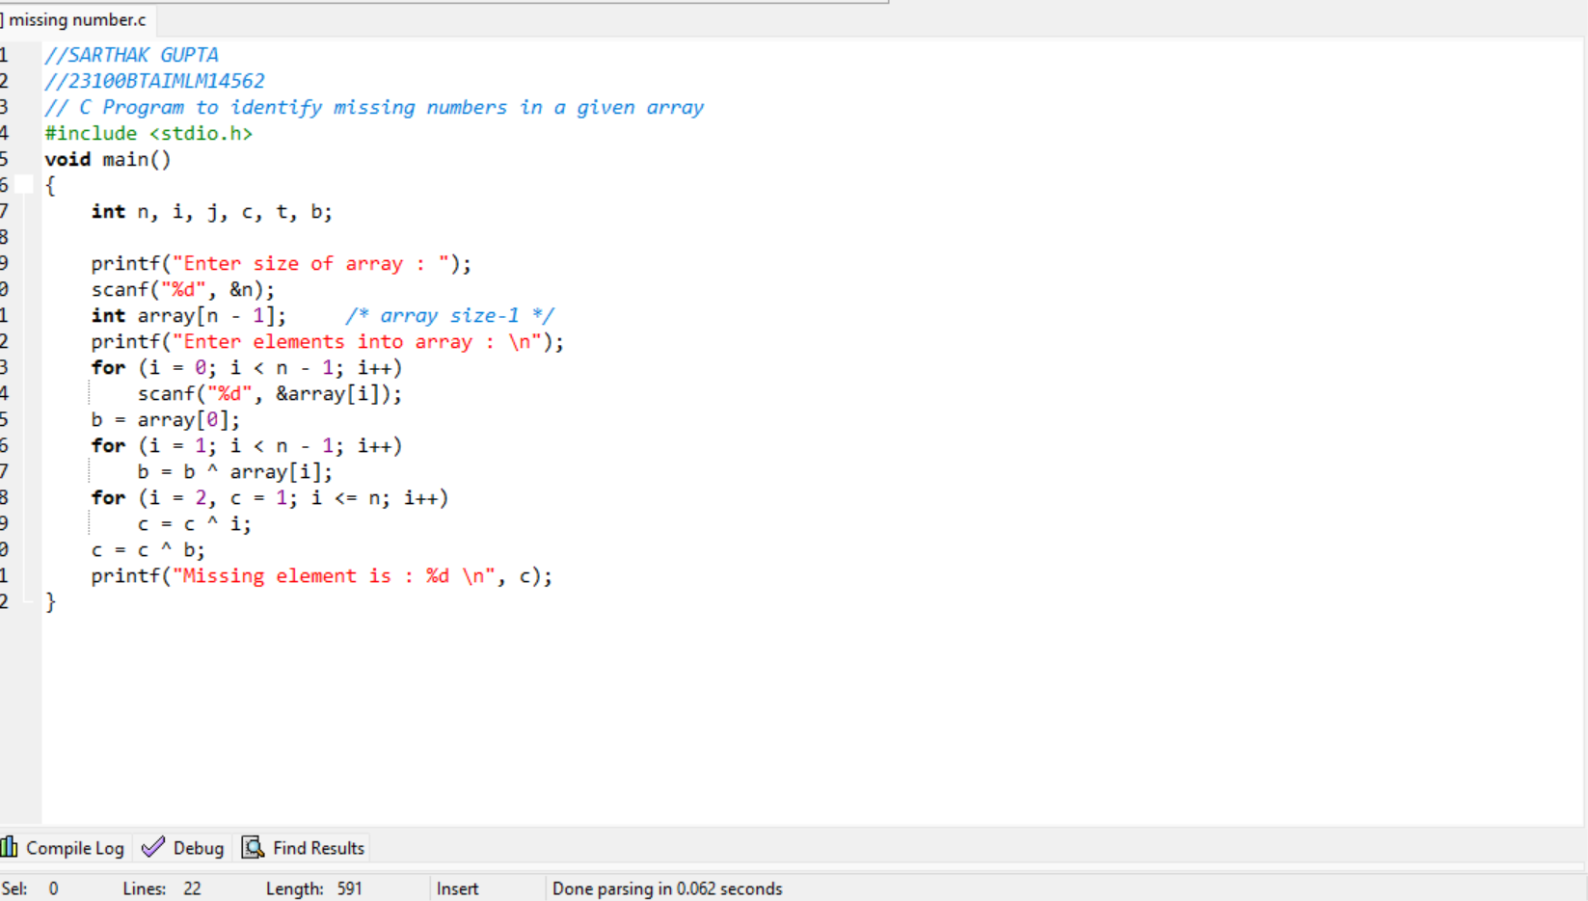
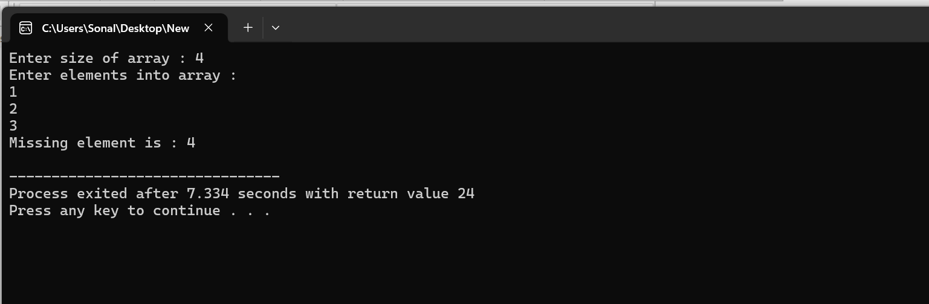
Shri Vaishnav Vidhyapeeth Vishwavidayalaya
Shri Vaishnav Institute of Information Technology
Indore-Ujjain Road, Indore-453111
Input:-
Output:-

Slide 22
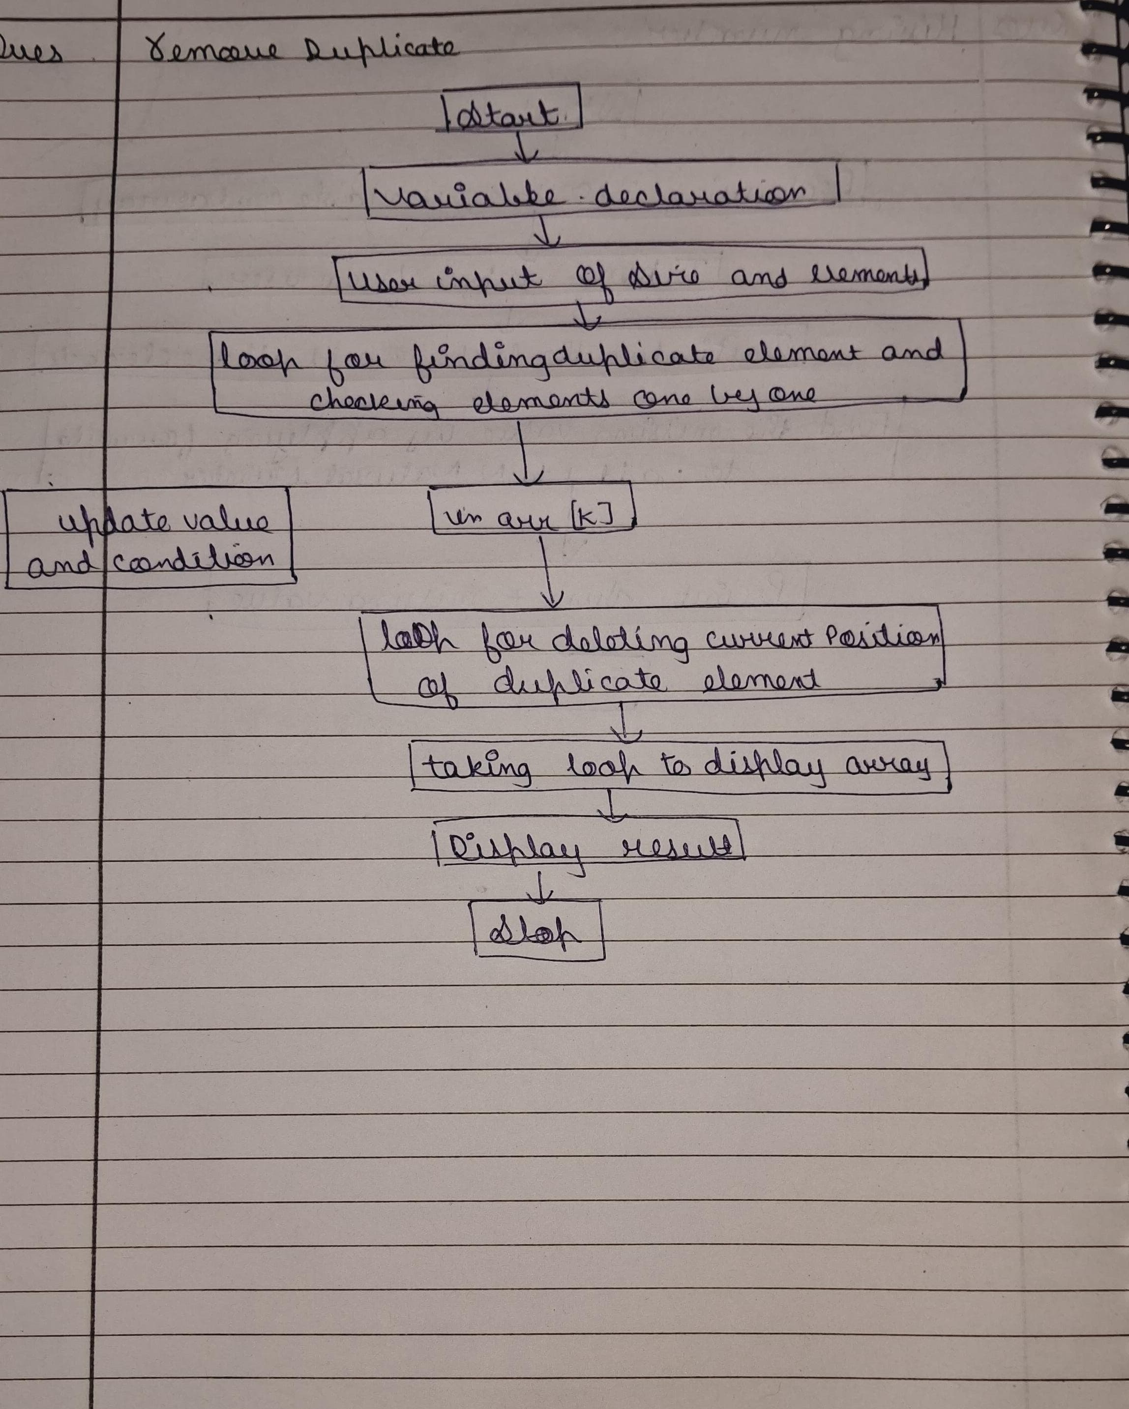
Shri Vaishnav Vidhyapeeth Vishwavidayalaya
Shri Vaishnav Institute of Information Technology
Indore-Ujjain Road, Indore-453111
Remove Duplicates From A Sorted Array:-
Aim:- Implement a function to remove duplicate elements from a sorted array and return the new length of the array.
Theory:-

Slide 23
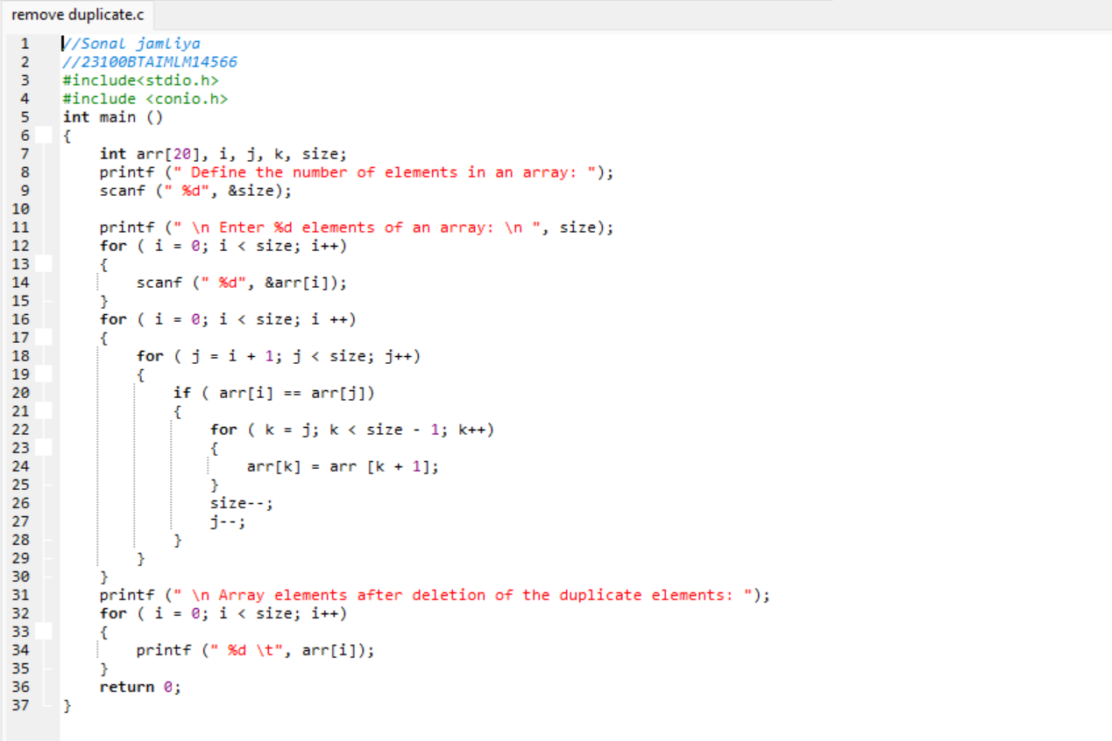
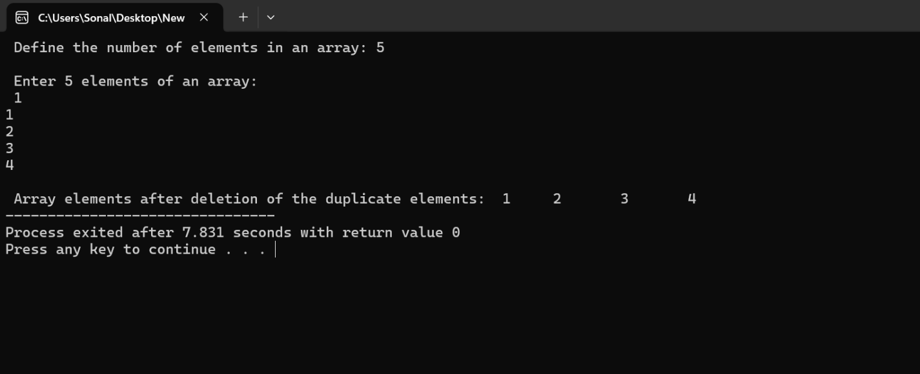
Shri Vaishnav Vidhyapeeth Vishwavidayalaya
Shri Vaishnav Institute of Information Technology
Indore-Ujjain Road, Indore-453111
Input:-
Output:-

Slide 24
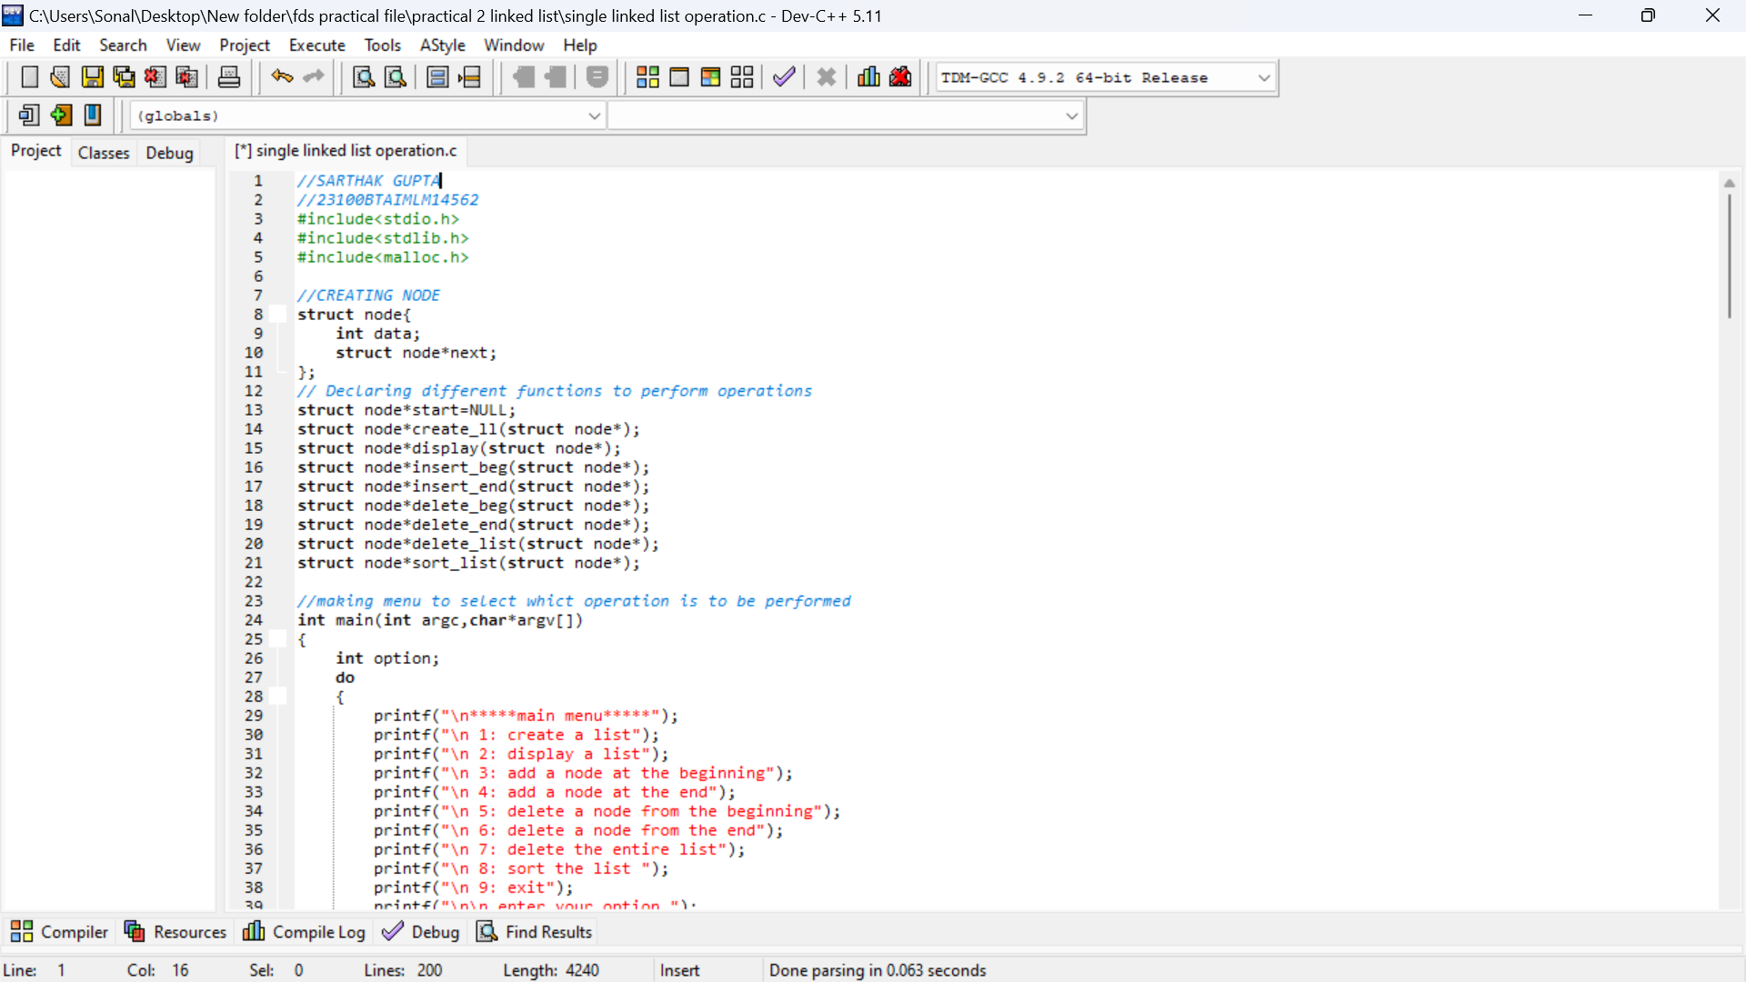
Shri Vaishnav Vidhyapeeth Vishwavidayalaya
Shri Vaishnav Institute of Information Technology
Indore-Ujjain Road, Indore-453111
Program No.:- 02
1. Perform all possible operations on linked list
Aim:- perform operation
Input:-

Slide 25
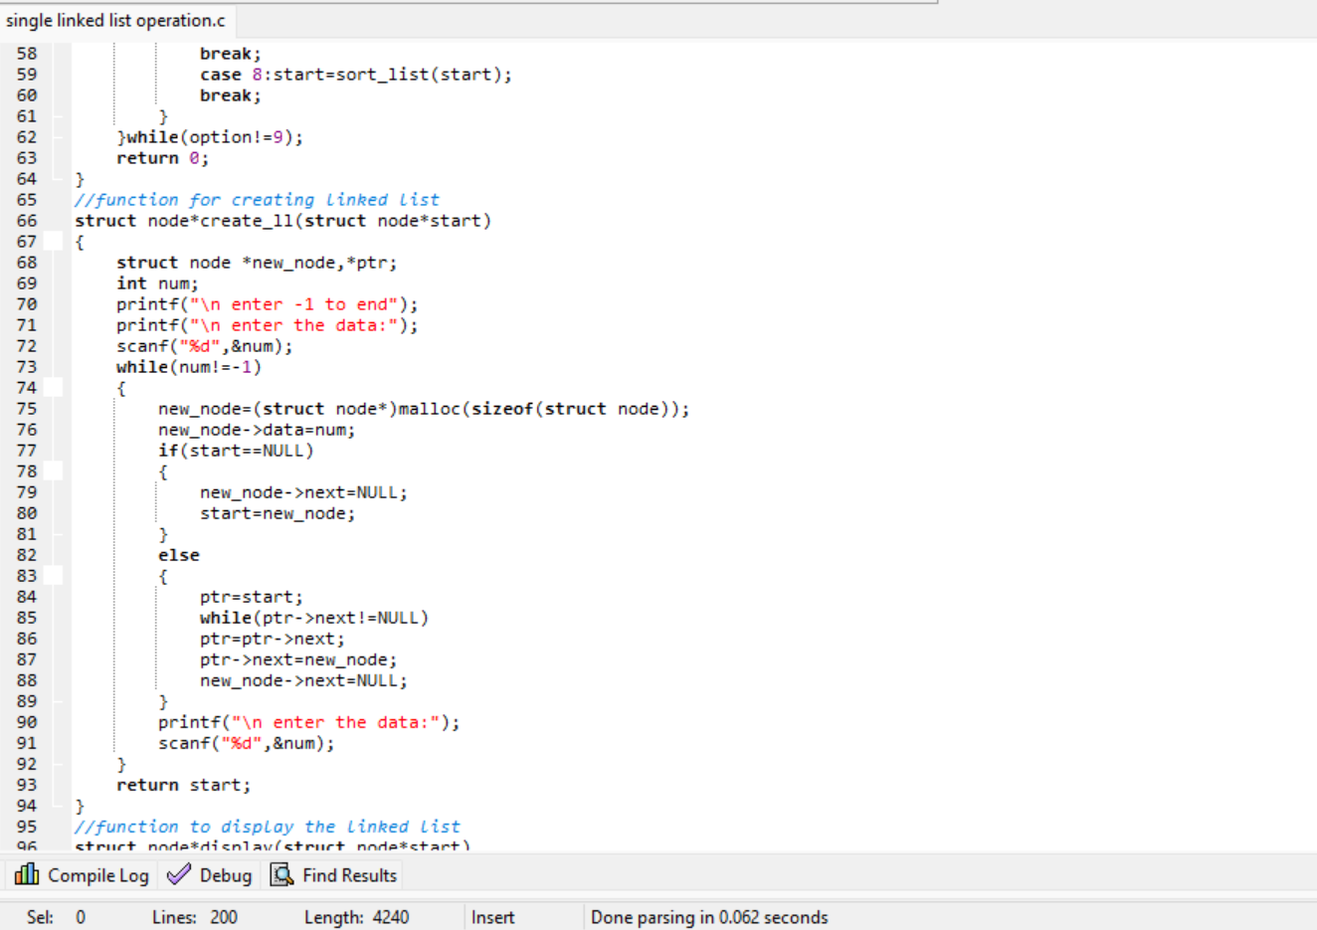
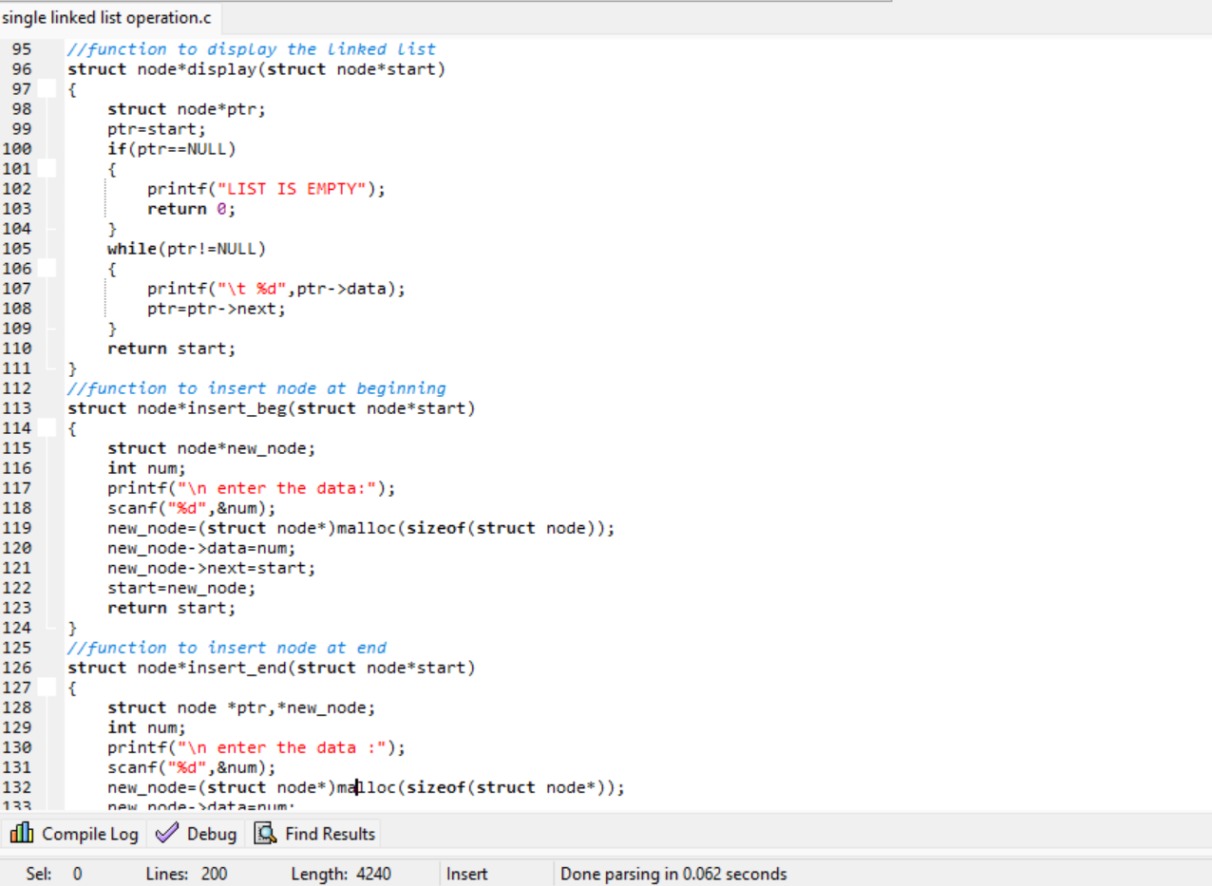
Shri Vaishnav Vidhyapeeth Vishwavidayalaya
Shri Vaishnav Institute of Information Technology
Indore-Ujjain Road, Indore-453111

Slide 26
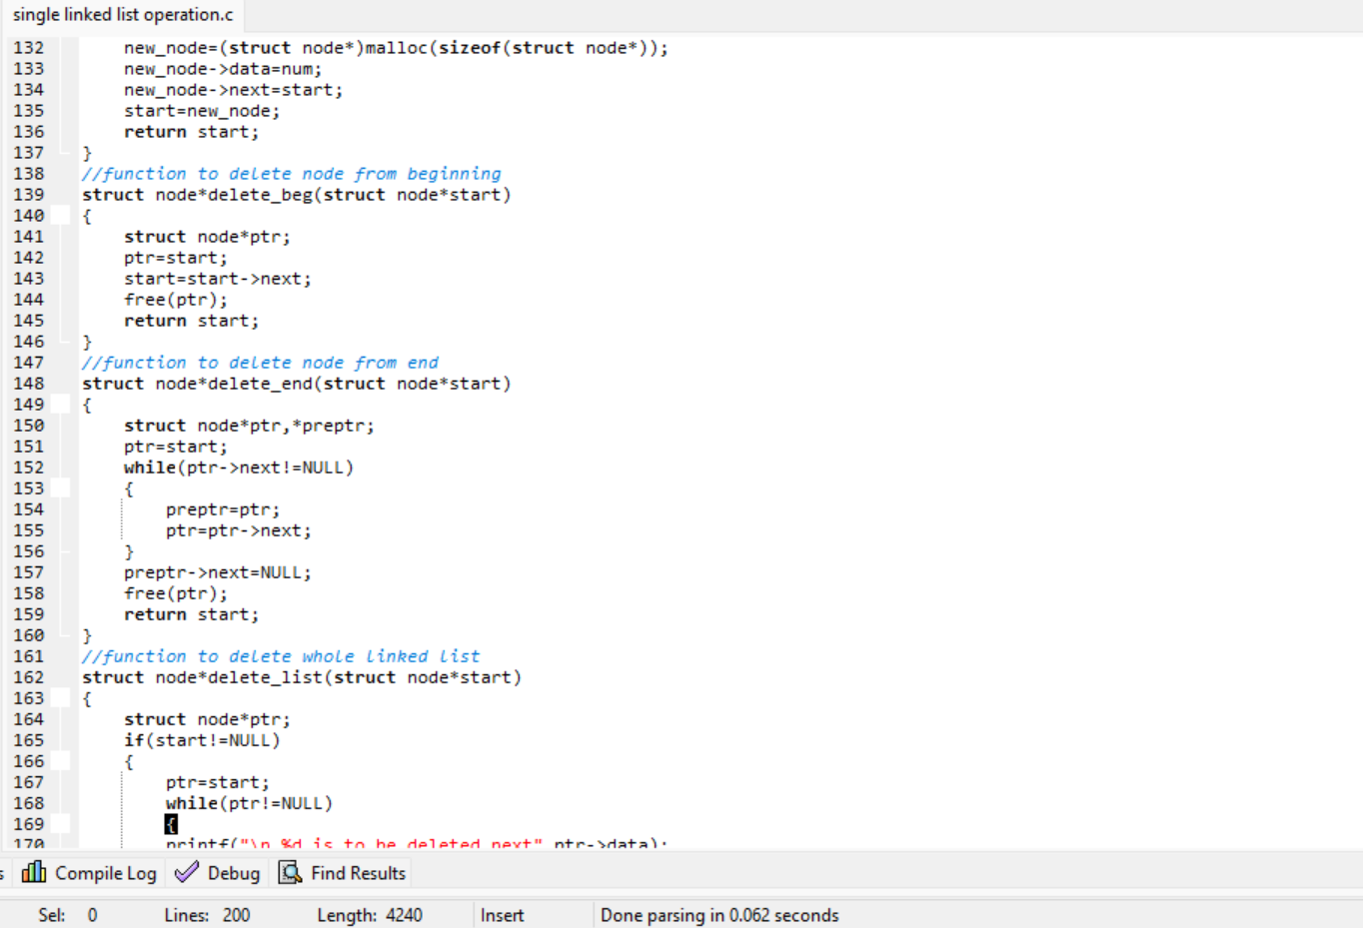
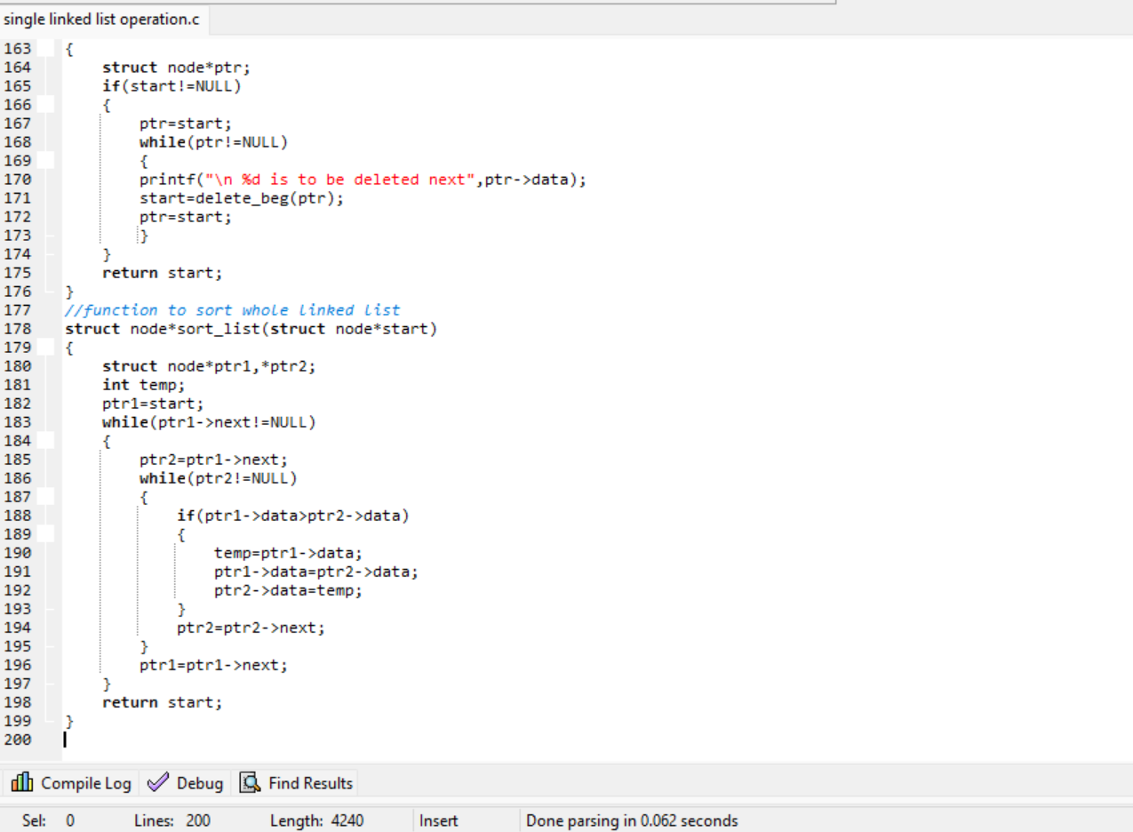
Shri Vaishnav Vidhyapeeth Vishwavidayalaya
Shri Vaishnav Institute of Information Technology
Indore-Ujjain Road, Indore-453111

Slide 27
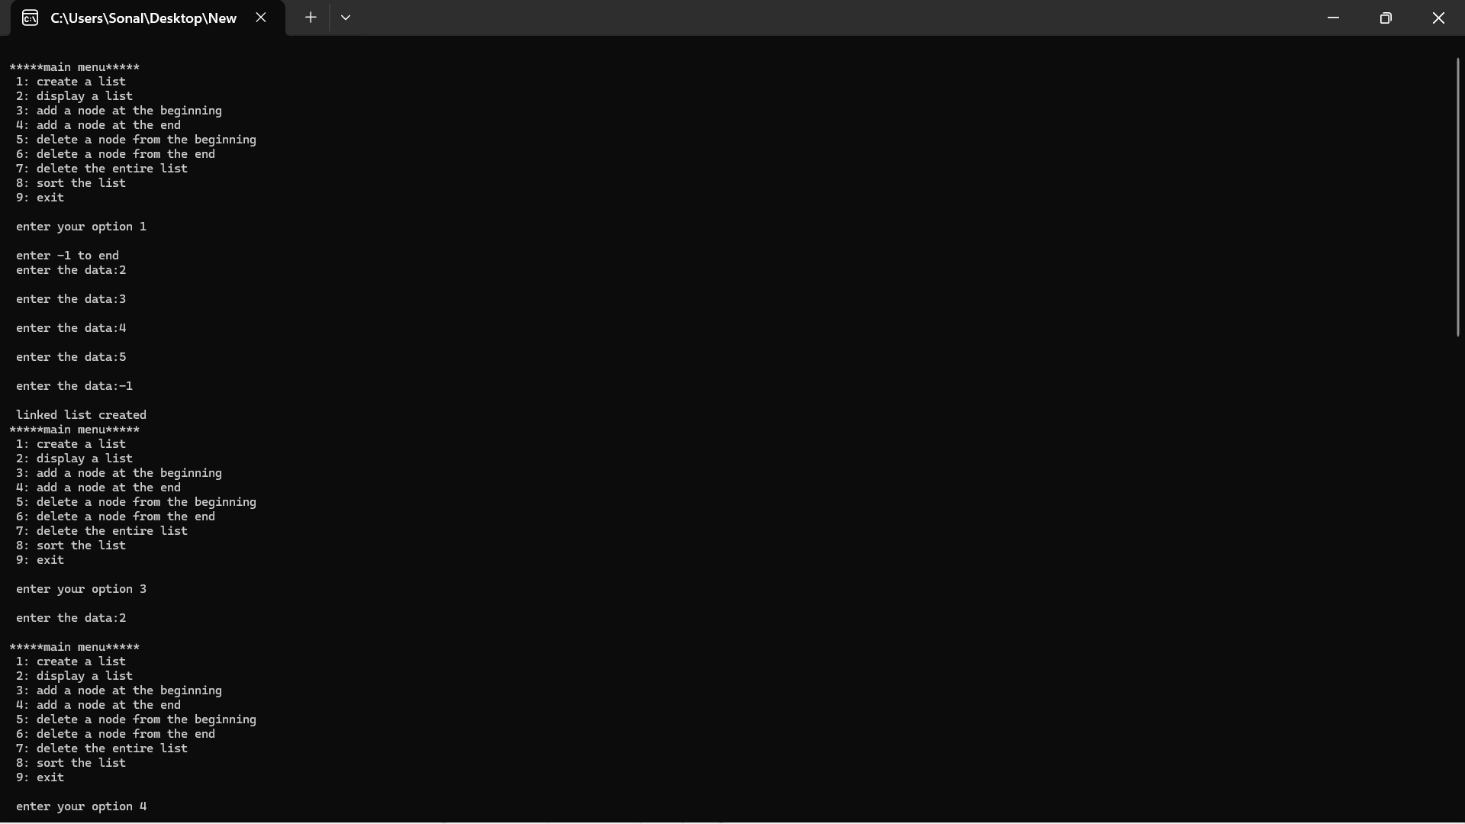
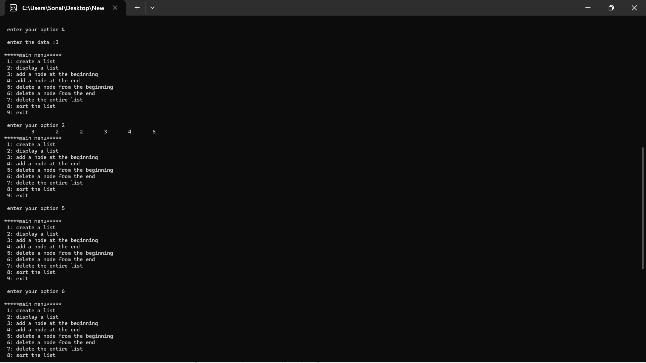
Shri Vaishnav Vidhyapeeth Vishwavidayalaya
Shri Vaishnav Institute of Information Technology
Indore-Ujjain Road, Indore-453111

Slide 28
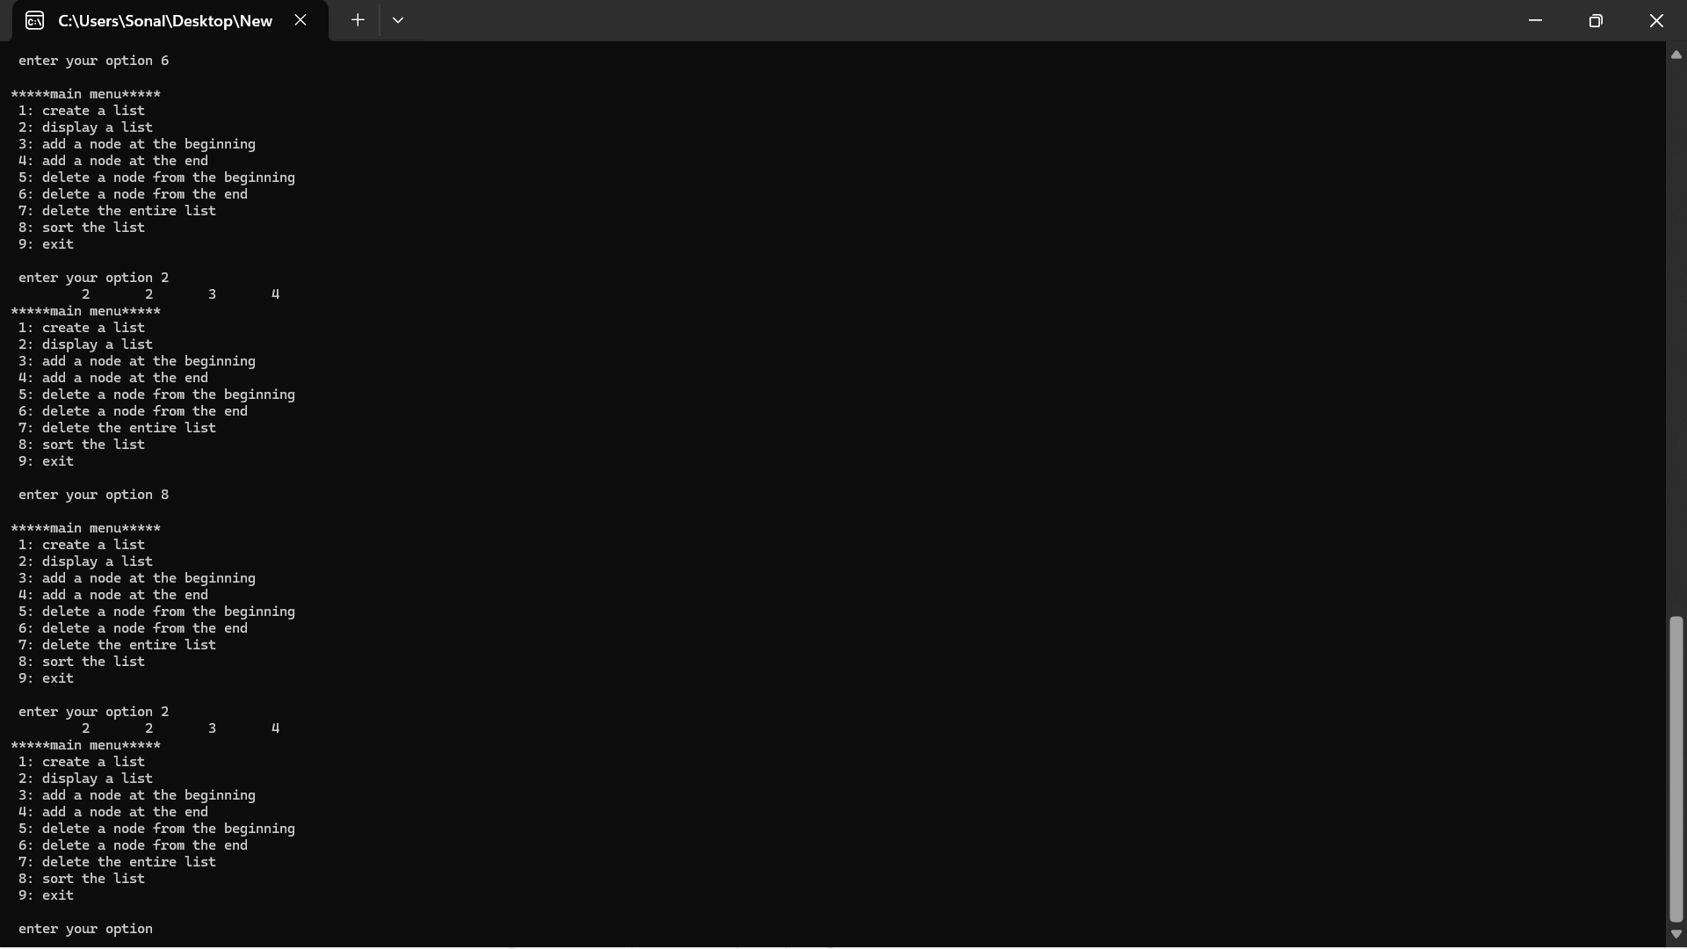
Shri Vaishnav Vidhyapeeth Vishwavidayalaya
Shri Vaishnav Institute of Information Technology
Indore-Ujjain Road, Indore-453111

Slide 29
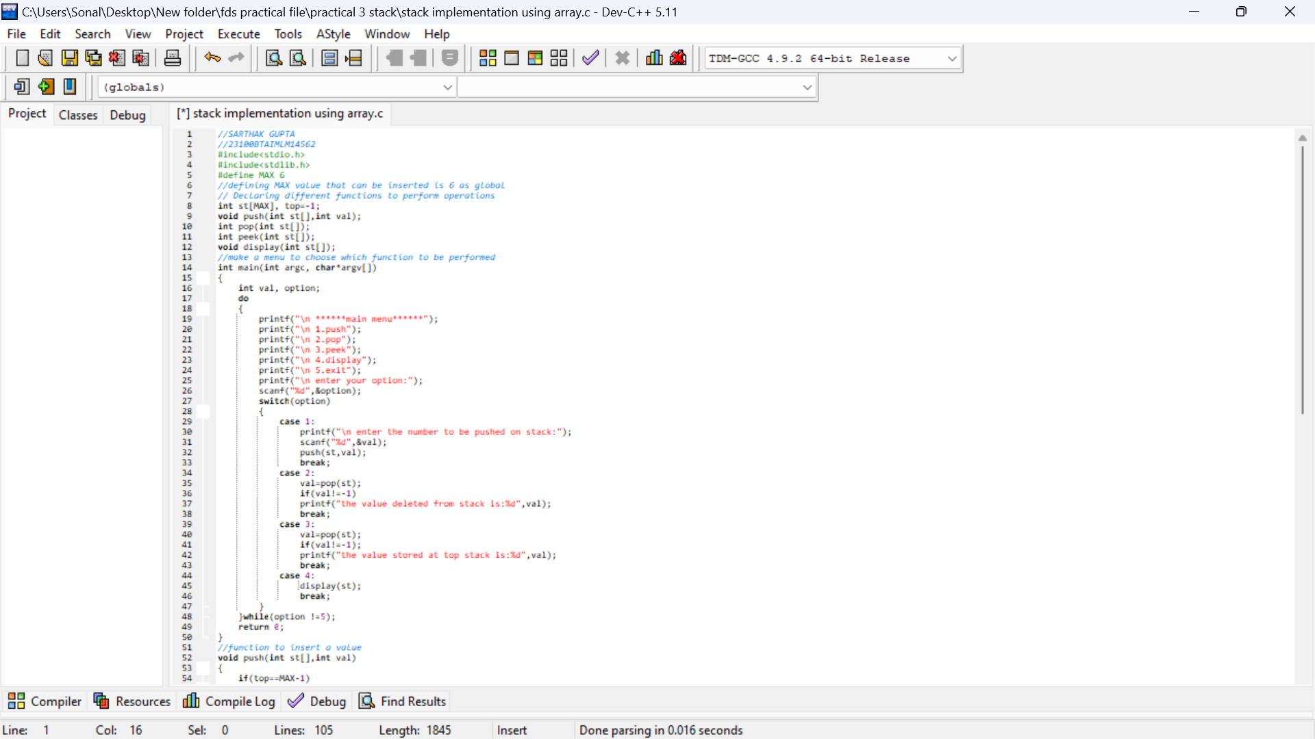
Shri Vaishnav Vidhyapeeth Vishwavidayalaya
Shri Vaishnav Institute of Information Technology
Indore-Ujjain Road, Indore-453111
Practical No.:- 03
1. Implementation of stack using array:-
Aim:- write a program to show implementation of stack using array input:-
Input:-

Slide 30
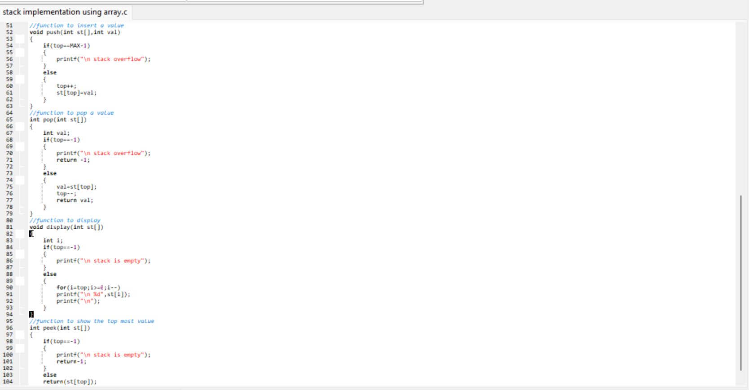
Shri Vaishnav Vidhyapeeth Vishwavidayalaya
Shri Vaishnav Institute of Information Technology
Indore-Ujjain Road, Indore-453111
40

Slide 31
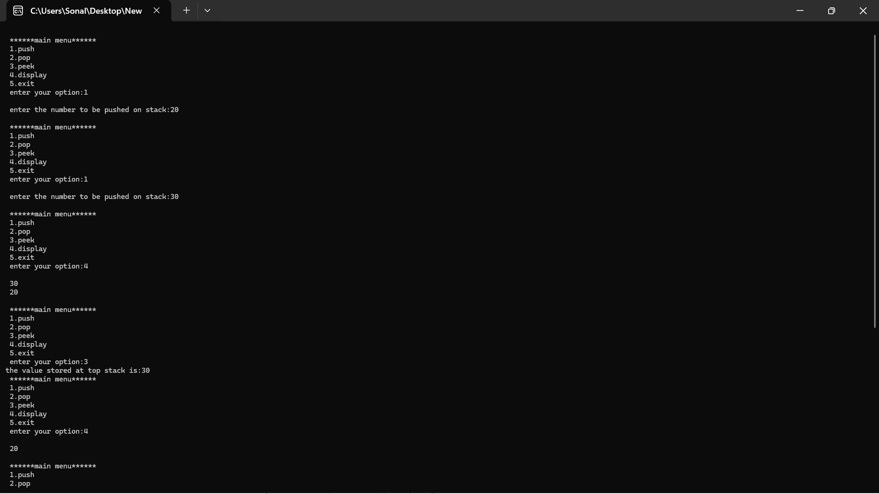
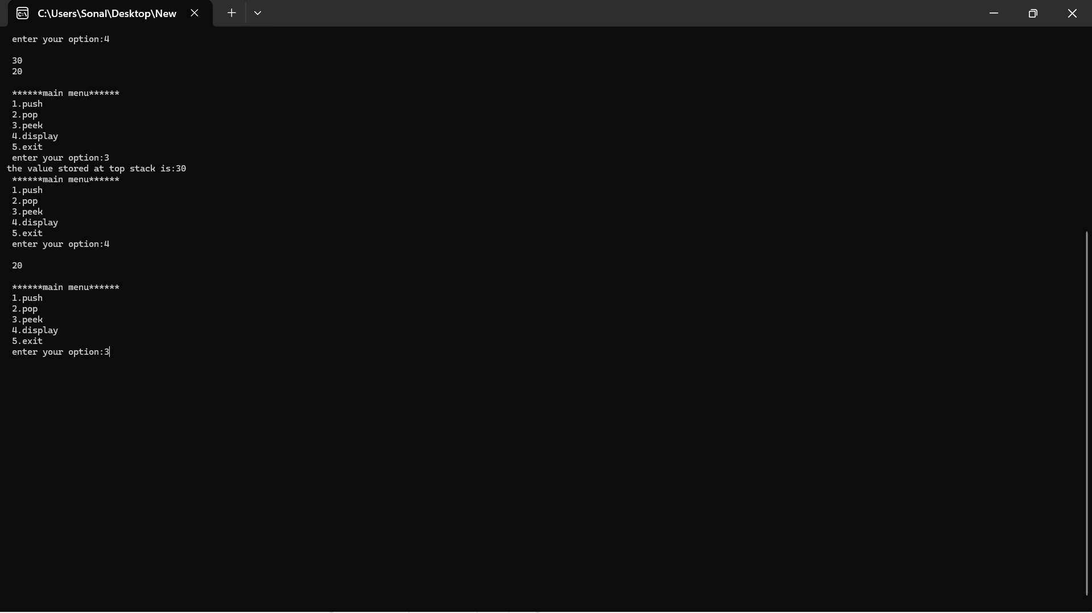
Shri Vaishnav Vidhyapeeth Vishwavidayalaya
Shri Vaishnav Institute of Information Technology
Indore-Ujjain Road, Indore-453111
Output:-

Slide 32
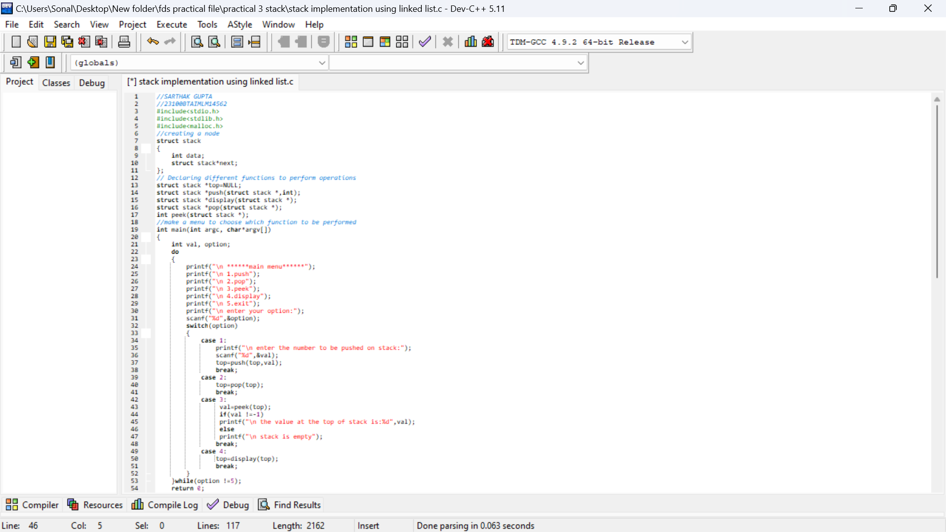
Shri Vaishnav Vidhyapeeth Vishwavidayalaya
Shri Vaishnav Institute of Information Technology
Indore-Ujjain Road, Indore-453111
2. Implementation of stack using linked list:-
Aim:- write a progam to show implementation of stack using linked list inputs:-
Input:-

Slide 33
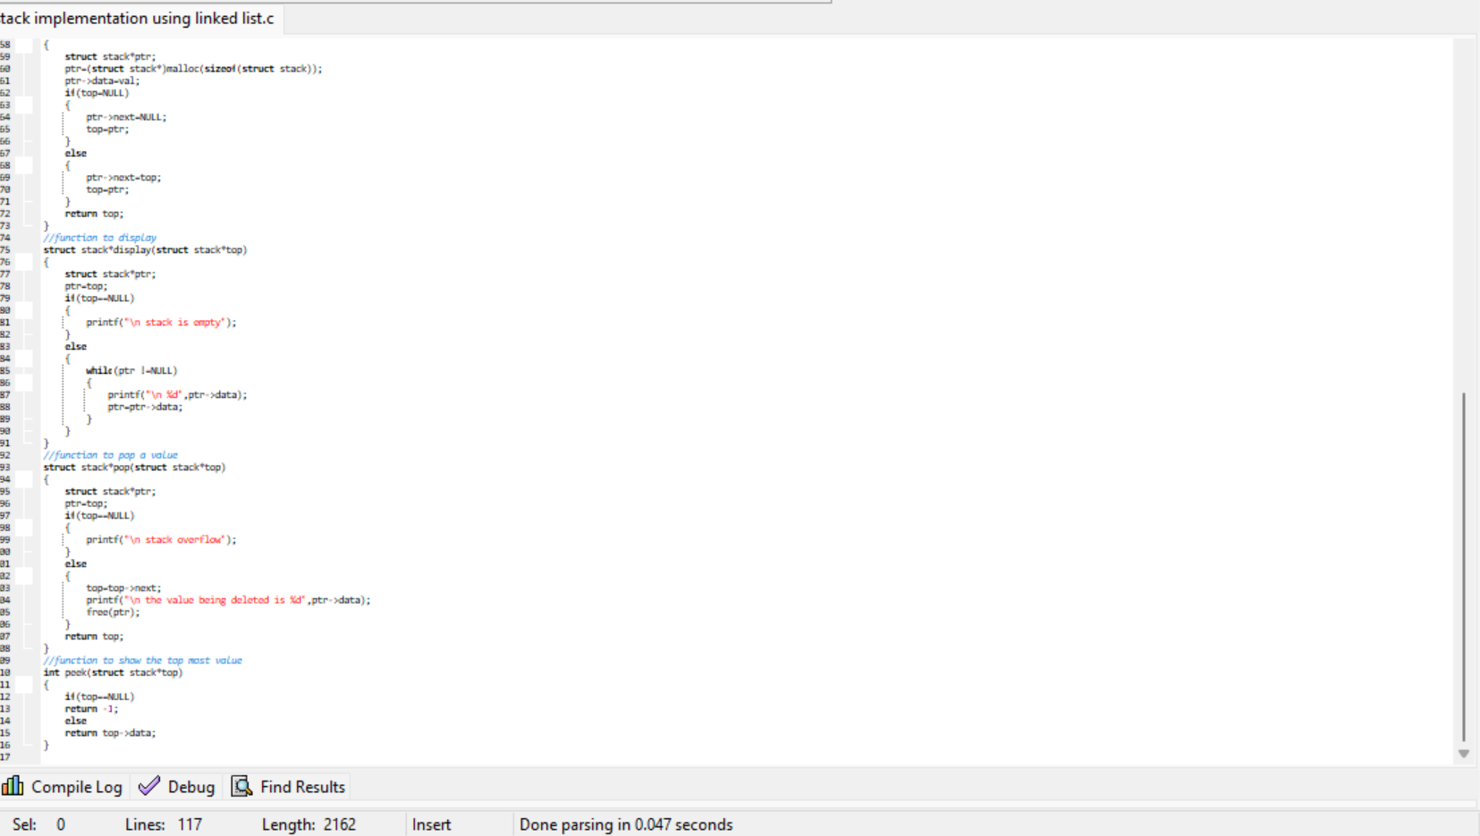
Shri Vaishnav Vidhyapeeth Vishwavidayalaya
Shri Vaishnav Institute of Information Technology
Indore-Ujjain Road, Indore-453111

Slide 34
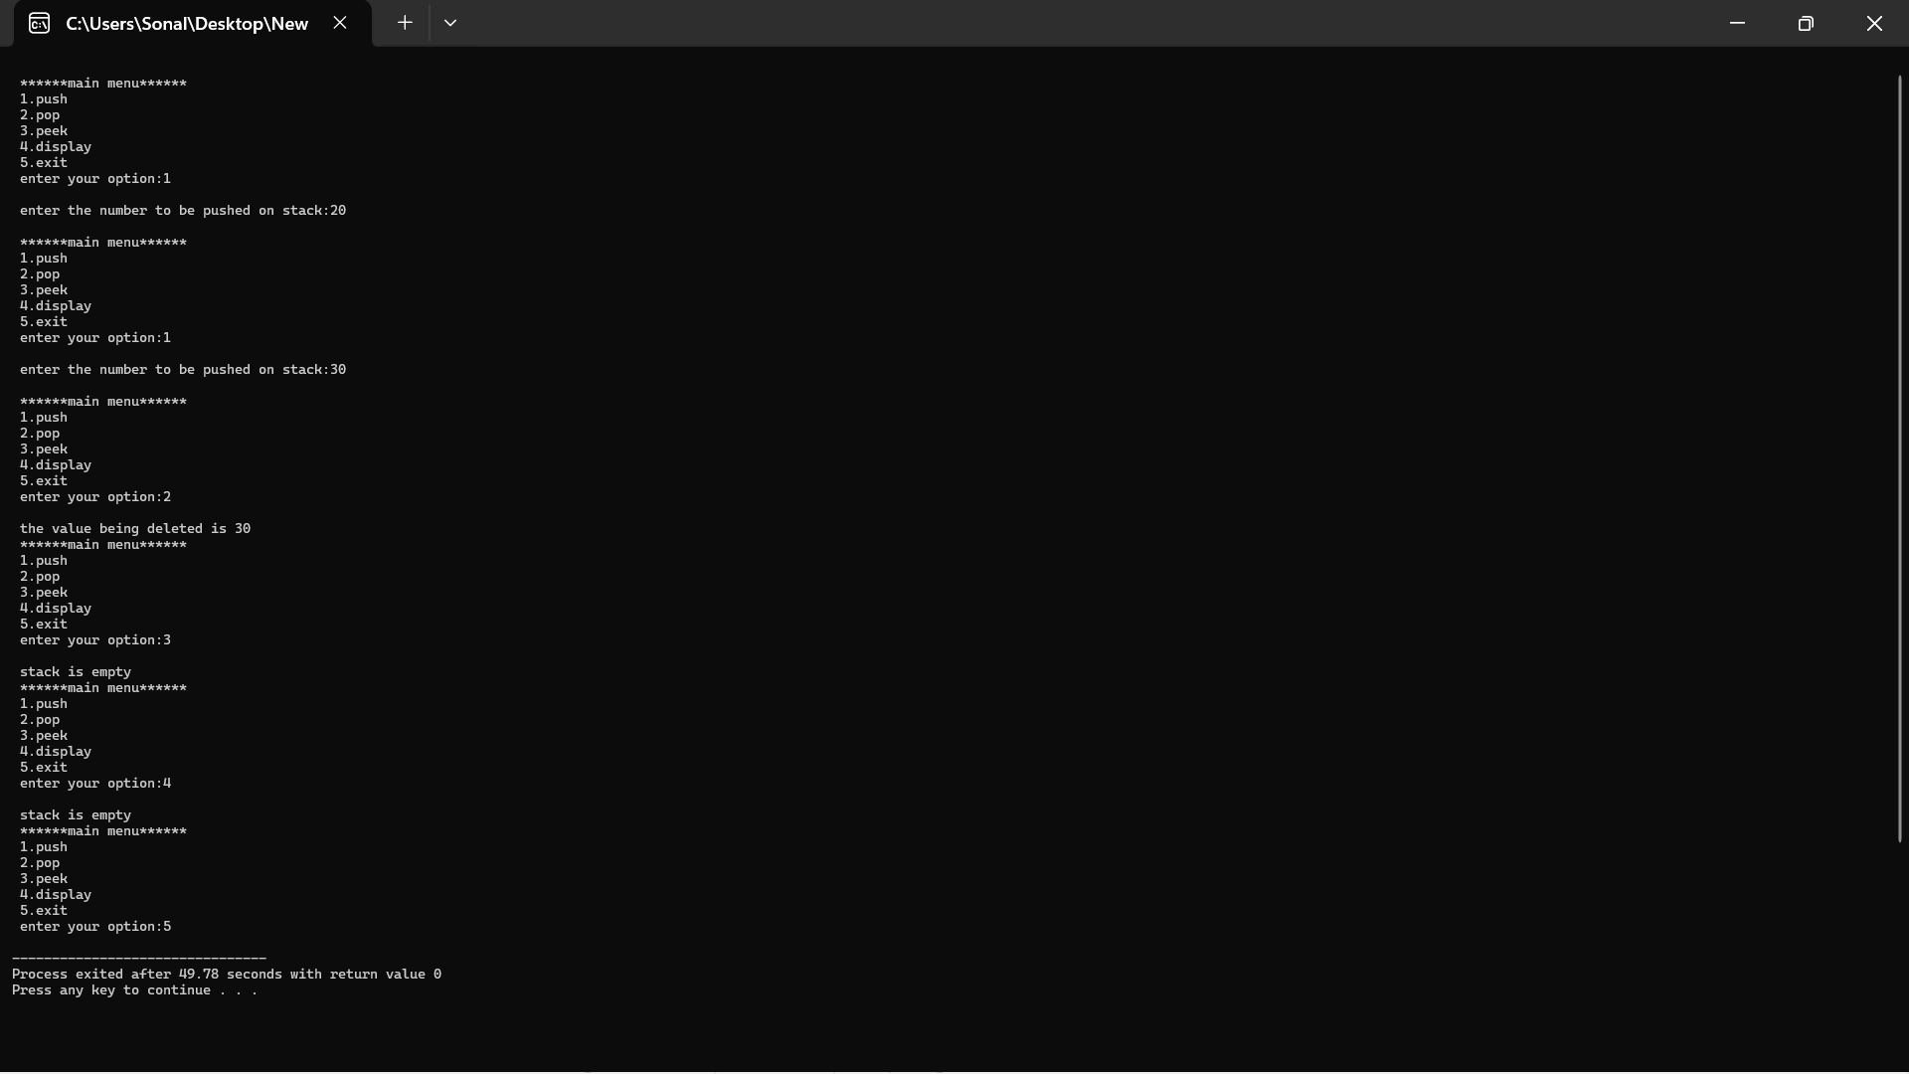
Shri Vaishnav Vidhyapeeth Vishwavidayalaya
Shri Vaishnav Institute of Information Technology
Indore-Ujjain Road, Indore-453111
Output:-

Slide 35

Shri Vaishnav Vidhyapeeth Vishwavidayalaya
Shri Vaishnav Institute of Information Technology
Indore-Ujjain Road, Indore-453111
Practical No.:- 04
1. Array implementation of queue.
Aim:- write a program to show implementation of queue using array.
Input:-

Slide 36
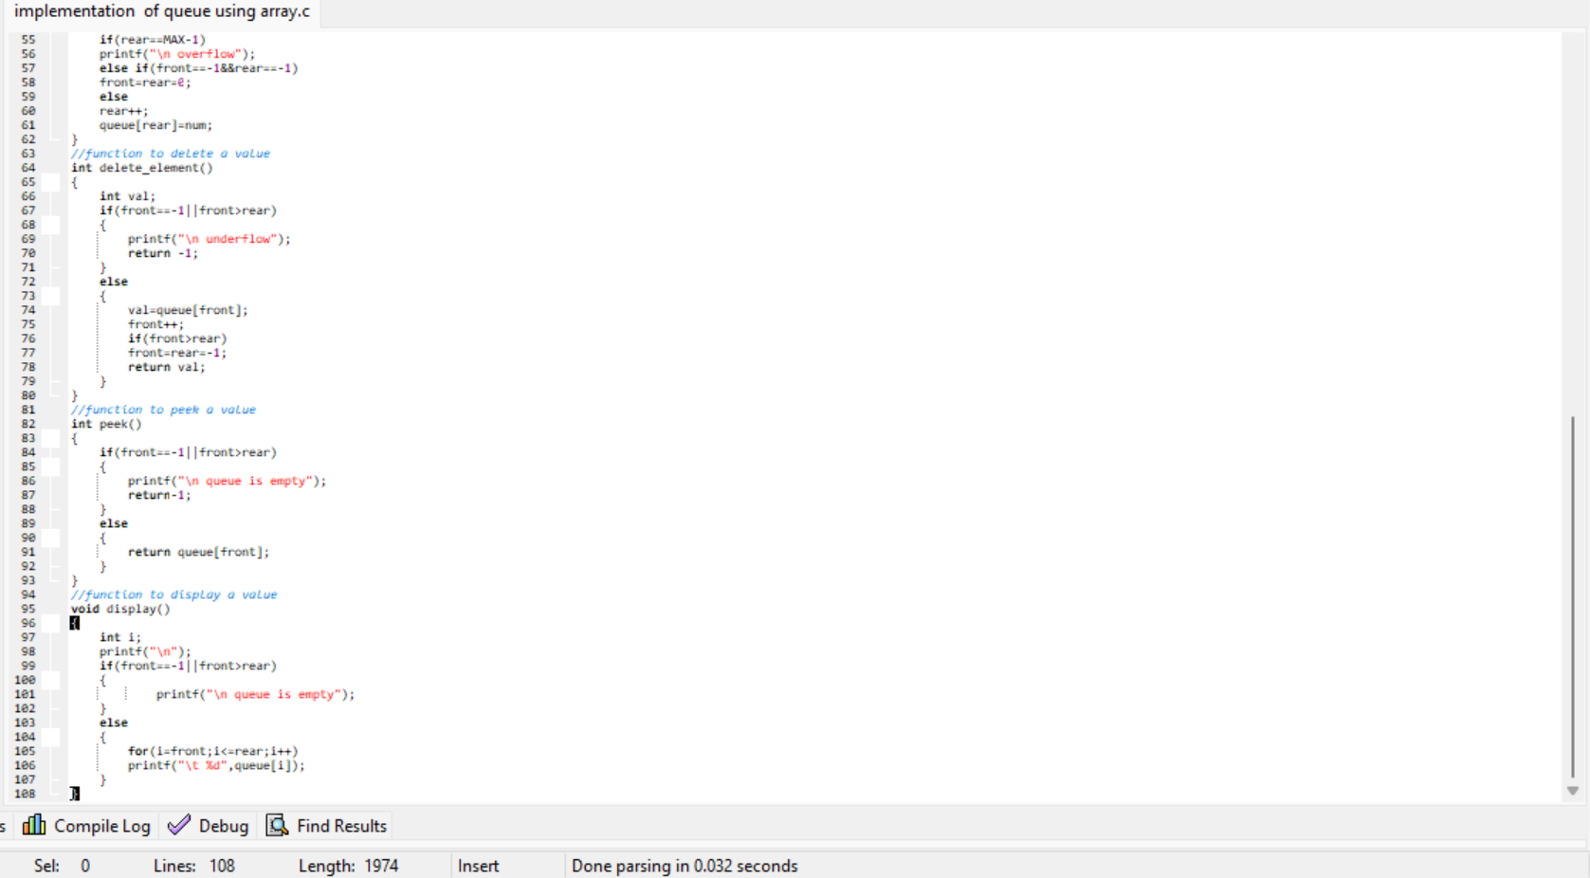
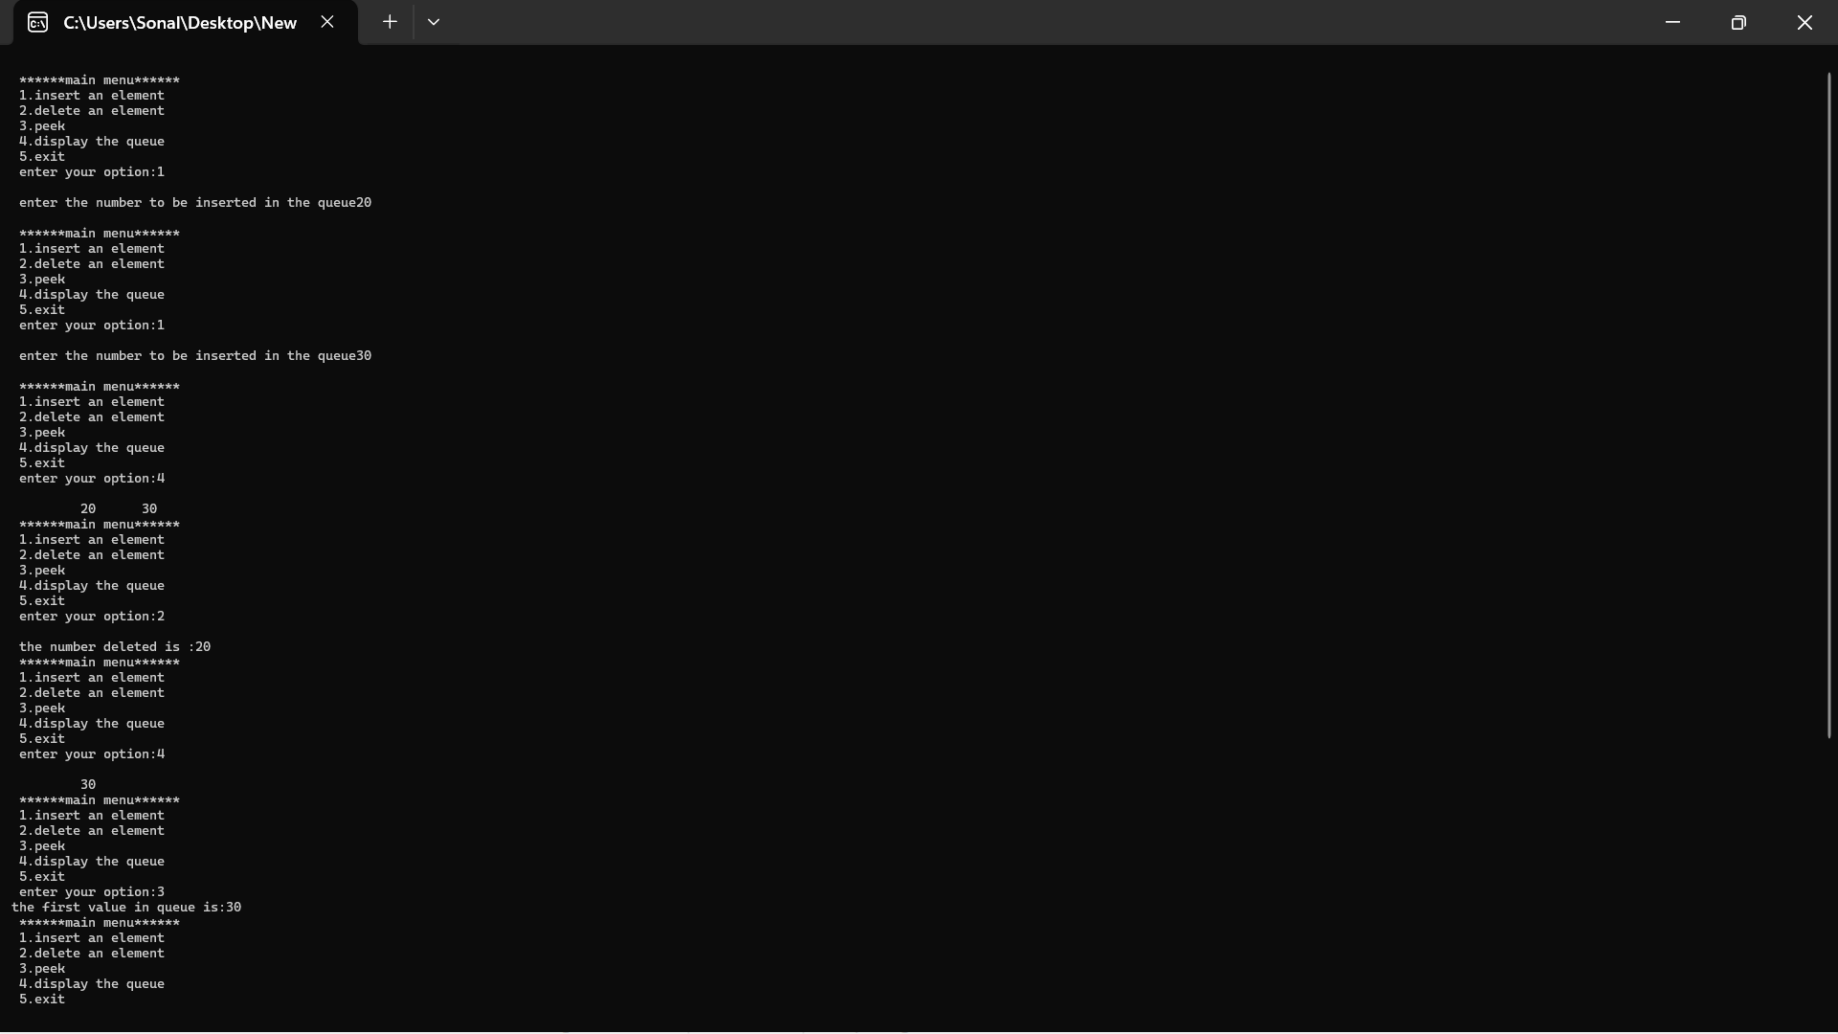
Shri Vaishnav Vidhyapeeth Vishwavidayalaya
Shri Vaishnav Institute of Information Technology
Indore-Ujjain Road, Indore-453111
Output:-

Slide 37
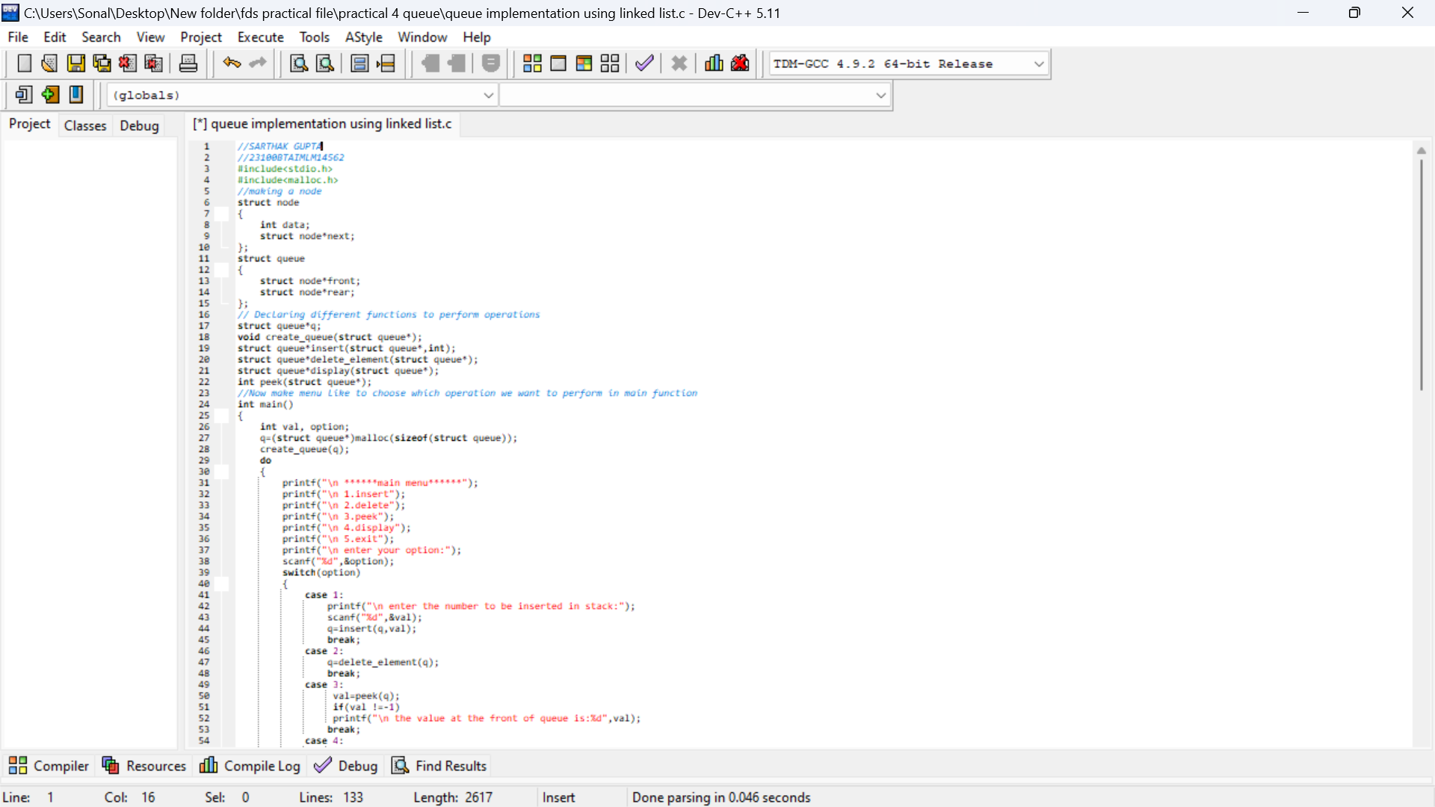
Shri Vaishnav Vidhyapeeth Vishwavidayalaya
Shri Vaishnav Institute of Information Technology
Indore-Ujjain Road, Indore-453111
Linked list implementation of queue.
Aim:- write a program to show implementation of queue using linked list.
Input:-

Slide 38
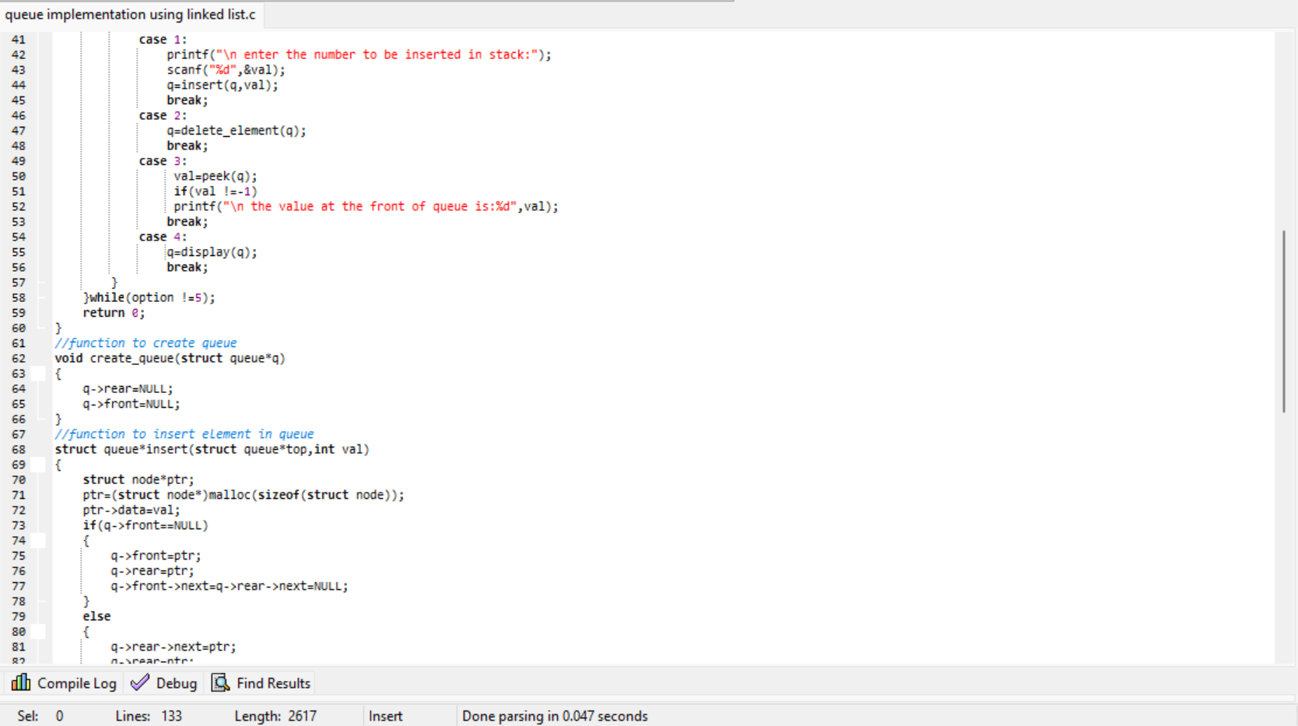

Shri Vaishnav Vidhyapeeth Vishwavidayalaya
Shri Vaishnav Institute of Information Technology
Indore-Ujjain Road, Indore-453111

Slide 39

Shri Vaishnav Vidhyapeeth Vishwavidayalaya
Shri Vaishnav Institute of Information Technology
Indore-Ujjain Road, Indore-453111

Slide 40

Shri Vaishnav Vidhyapeeth Vishwavidayalaya
Shri Vaishnav Institute of Information Technology
Indore-Ujjain Road, Indore-453111
Output:-
50

Slide 41

Shri Vaishnav Vidhyapeeth Vishwavidayalaya
Shri Vaishnav Institute of Information Technology
Indore-Ujjain Road, Indore-453111
Program No.:- 05
1. Deletion opertation on binary search tree.
Aim:- write a program to construct a binar search tree and perform deletion in order traversal on it.
Input:-

Slide 42


Shri Vaishnav Vidhyapeeth Vishwavidayalaya
Shri Vaishnav Institute of Information Technology
Indore-Ujjain Road, Indore-453111

Slide 43

Shri Vaishnav Vidhyapeeth Vishwavidayalaya
Shri Vaishnav Institute of Information Technology
Indore-Ujjain Road, Indore-453111
Output:-

